Slide 1
IES Aviation Lighting Committee
Fall Technology Conference
“Full-Capability, Full-Functionality,
Solid-State-based,
In-pavement Runway Lighting”
October 20, 2015
SPECTRUM FML

Slide 2
Next-Gen MR-16: The Next Evolution
Products must precisely duplicate the visible and ‘usable’ IR photometrics of existing, legacy FAA MR16, at all FAA specified Step levels.
Power-management Design must mitigate PWM-induced prop stroboscopic interaction
Products must significantly improve the energy savings and useful life of existing, legacy FAA MR16 lamps.
Products must have an MR-16 ‘lamp’ form-factor.
Products should ideally require no special ice/snow kit
Notes:
For the past day and a half you have heard much discussion of the benefits of Solid-state / LED lighting, as applied to the airfield environment. I am now going to present some ideas on how that foundation can be strengthened and built upon.

Slide 3
Solid State Evolution: Integrated IR & Visible
FAA Operational Imperatives
SSL Operational Issues
Targeted Solution
Technology Challenges
Progress with Solid-state IR
Energy efficient, IR-compliant, SSL-based MR16, for use in L-850/852-series lights
Notes:
Sub-title: "The unfulfilled promise of a solid state MR-16…":
Equivalent visual pattern, without hotspots
Equivalent IR signature
Efficient cold-weather performance
Energy and maintenance savings

Slide 4
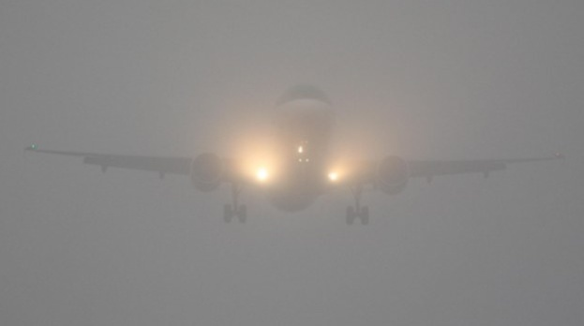
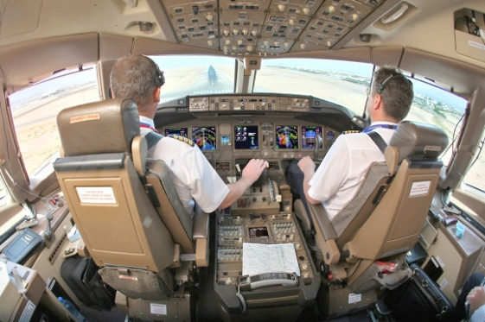
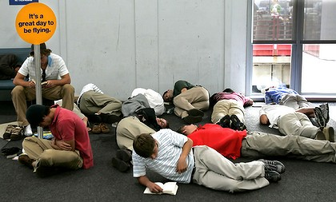
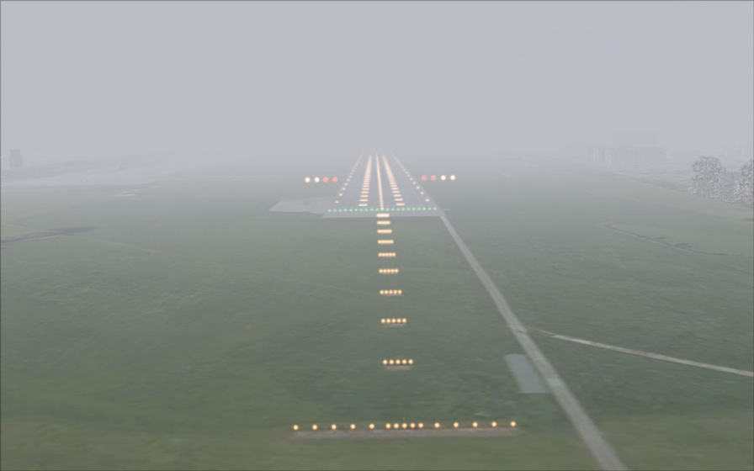
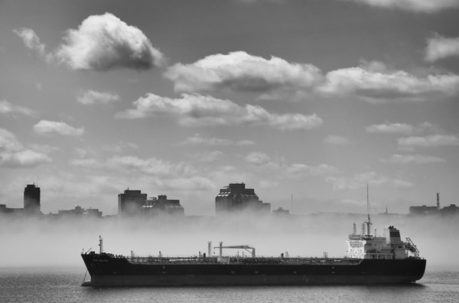
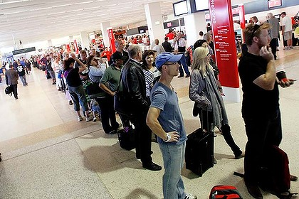
Today – 70% of air traffic delays are caused by weather, adding $41B in annual costs and customer dissatisfaction¹
Solid State Evolution: Operational Imperatives
Delays
Safety
Inconvenience
1.U.S. National Airspace data. Source: OPSNET, Congressional Joint Economic Committee, Joint Planning and Development Office (JPDO).
Notes:
Weather-related delays are:
costly,
a nuisance
Can easily have safety implications

Slide 5
SSL Impact: Execution Issues
Current cockpit-perspective on SSL in-pavement products indicates potential safety issues with visual intensity and/or glare.
Why?
Notes:
There are more or less two schools of thought on this issues:
1) It is an implementation issue: most discussion yesterday and today so far are in this camp
2) It is a design issue: many in the Science Groups and Ops Group are outspoken in the fact that whatever it’s ‘cause’ it must be addressed

Slide 6
Solid State Solution: Execution Issues
“Perceived Brightness of Incandescent and LED Aviation Signal Lights”
John D. Bullough, et al (2007)
Aviation, Space, and Environmental Medicine • Vol. 78, No. 9 • September 2007
Conducted a series of carefully-designed experiments and data analyses to better understand why, “Aviation lights using light emitting diodes are commonly perceived as brighter than those using incandescent sources, even at the same measured intensity.”
Conclusion included a defined mathematical model that very accurately predicts brightness levels based on physical properties of the LED source vs the incandescent source.
Notes:
Yesterday, Donald Lampkins spoke of the B/L ratio and how they will factor that number into their testing process for the LED PAR-38…
For me, Dr. Bullough’s 2007 white paper made solid inroads into at least one of the factors behind LED-based glare.

Slide 7
Solid State Solution: Execution Issues
“Perceived Brightness of Incandescent and LED Aviation Signal Lights”
Hypothesis: “Thus, consistent with theoretical expectations, the more saturated LED signal lights should appear brighter than typical desaturated, filtered incandescent signal lights of the same hue and luminous intensity.”
Sample finding: “Moreover, it should be noted that even lights with the same CCT can have very different chromaticities and will not necessarily have the same B/L values.”
Sample finding: “The VD-RS model developed and described here provides a framework for specifying the B/L values for any signal lights within the blue, white, and green color specifications.”

Slide 8
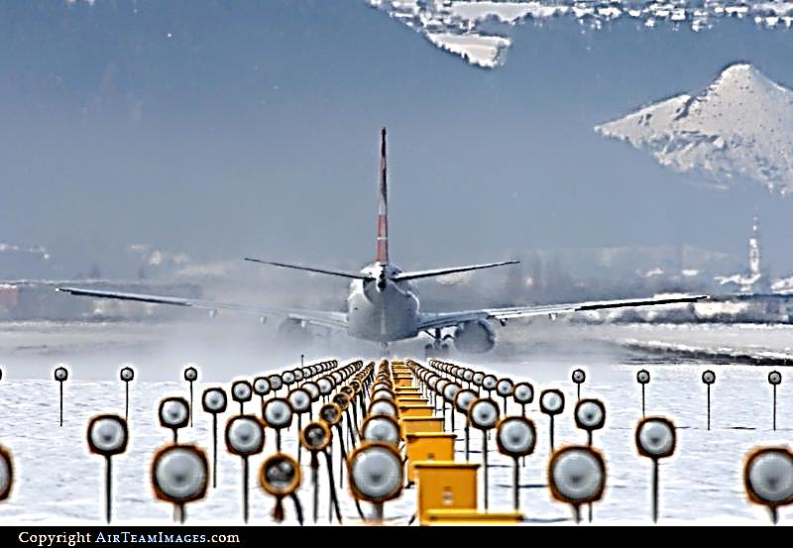
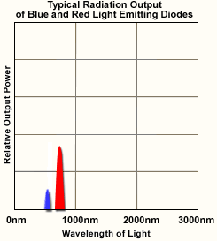
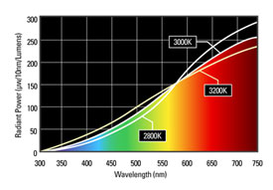
Incandescent lights and LEDs: Photometrics
Incandescent Light Is A Broad Band Transmitter
LED Light is a Narrow Band Transmitter

Slide 9
Solid State Evolution: Execution Issues
SSL products are certified/qualified using criteria updated in EB-67D, yet many pilots continue to report significant differences in brightness (generally described as ‘glare’).
What now?
Notes:
Something is being missed. Some aspect of how those LED sources are designed, or tested, or installed is creating this anomaly.
Ops Flight Test Group has now had funding approved to runway-approach testing
A radiometer is going to be co-located on the cockpit glare shield with a high-def visual camera
they will fly approaches at designated airports in targeted metrological conditions

Slide 10
Solid State Evolution: SSL Impact
Current deficit as regards Infrared signature from SSL-based lighting.
Why?

Slide 11
Solid State Evolution: SSL-IR Limitations
Solid-state-based IR signatures
SSL physics of LED junction temp (T_{C}) vs IR signature
SSL L₇₀ (useful life) performance suffers at very high T_{C}
SSL Photonics
99% of all LED’s are designed and manufactured for “unprocessed” emissions in the UV range
Phosphor processing enables LED's to emit at more usable wavelengths
The longer the wavelength desired, the lower the overall electro-photonic efficiency drops
Majority of commercial IR-LED’s are limited to < ~1,000 nm

Slide 12
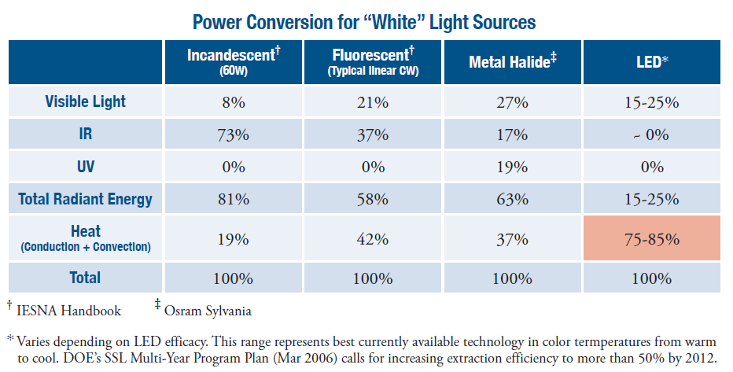
Solid State Evolution: SSL “IR”

Slide 13
Solid State Evolution: SSL Shortcuts
Current cockpit-perspective feedback on SSL products suggests safety issues with visual intensity and/or glare.
Why?
Current deficit as regards Infrared signature from SSL-based lighting.
Why?
Some SSL-based lighting solutions are not ‘lamp-based’ but rather bespoke LED ‘light engine’ modules.
Why?

Slide 14
Solid State Evolution: Project Challenges
Advanced Power Management
Maximize reliability and efficiency
Minimize and integrate form factor
Increase PWM rate to mitigate prop stroboscopic interaction
“Prop-Synchronized” PWM in Hz = # blades per prop x 38.33 cycles/second
For a 6-bladed prop, Prop-Synchronized PWM = 229 Hz
Therefore 350-400 Hz will mitigate stroboscopic interactions, and is easily achievable

Slide 15
Solid State Evolution: Project Challenges
‘Normalized’ Packaging
Meet FAA size and weight specification for MR-16
Integrated Optics
Minimize glare (duplicate incandescent beam angles)
Optimize output (IR signature, and visual CCT, Lumen, etc.)
Balanced Thermal Properties
Maximize ice and snow mitigation
Minimize SSL component operating temperatures
Maximized Useful Life (40-50,000 hours)
Notes:
“Prop-Synchronized” PWM in Hz assumes 2,300 RPM shaft speed

Slide 16
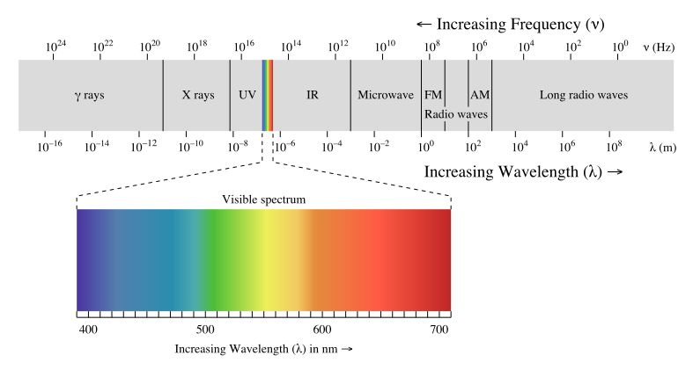
Problem #1 – IR Cameras and LED Lighting
Thermal cameras, including Enhanced Vision System cameras, cooled Indium Antimonide Focal Plane Arrays, on aircraft and helicopters do not function well with existing LED lighting.
IR Bands:
- Near Infrared (NIR): 750 nm to 1,400 nm
- Short Wave Infrared (SWIR): 1400 nm to 3000 nm,
- Medium Wave Infrared (MWIR): 3,000 nm and 8,000 nm
- Long Wave Infrared: 8,000 nm and 15,000 nm.
Notes:
So let’s talk some more about SSL-based IR…
IR Bands:
- Near Infrared (NIR): 750 nm to 1,400 nm
- Short Wave Infrared (SWIR): 1400 nm to 3000 nm,
- Medium Wave Infrared (MWIR): 3,000 nm and 8,000 nm
- Long Wave Infrared: 8,000 nm and 15,000 nm.

Slide 17
Incandescent lights and LEDs: Photometrics
Incandescent Light Is A Broad Band Transmitter
LED Light is a Narrow Band Transmitter
Notes:
So, current generation thermal cameras are tuned such that they work well with incandescent sourced airfield lighting.
Less so with SSL-sourced airfield lighting
[next] As Donald Lampkins noted yesterday, most thermal-imaging mfrs focus on 1,200-2,400 nm
[next] some thermal-imaging mfrs such as Elbit also tune for Medium Wave Infrared (MWIR): 3,000-5,000 nm
These wavelengths are selected due to their ability to penetrate moisture such as fog, rain and snow

Slide 18
Problem #2 – EFVS Investment (~2014)
FedEx
~250 aircraft equipped with EFVS
Gulfstream Aerospace
~420 aircraft equipped with EFVS
Bombardier
~125 aircraft equipped with EFVS
Dassault Falcon
Working toward Ops Certification
Embraer
Certification program for ECJ-190
Numerous After-market Suppliers
Notes:
So where are we now…
In January, we were approached by FAA and asked what could be done to iprove IR performance for airfield SSL lighting, specifically in-pavement lighting
We had know for several years that IR performance was deficient for SSL-based lighting and had been working with ORNL on a technology they had developed and patented several years earlier, Graphite Foam
GF, when excited in a particular way with a specifically designed AC induction coil, will emit IR. Copious amounts of IR
We worked with ORNL to further develop and tune that emitter to the IR wavelengths targeted by the thermal camera mfrs[next slide]?

Slide 19
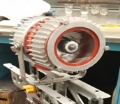
Solid State Evolution: R&D Milestone – January Prototype
Alpha Prototype Graphite Foam Infrared Lamp

Slide 20
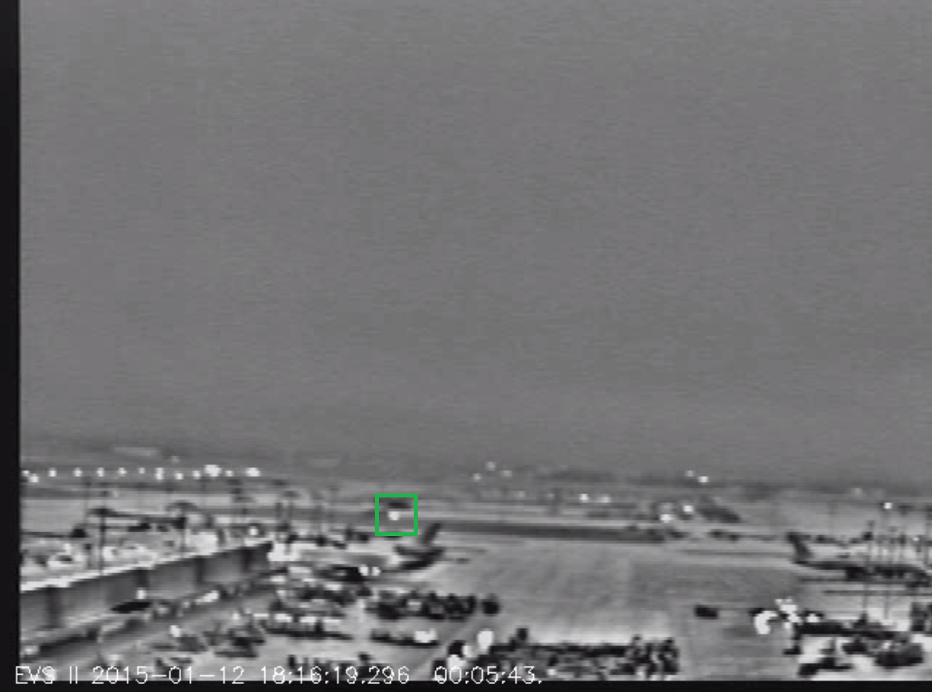
Elbit EVS II Image - GF IR Demo Light Clearly Visible from ½ mile.
Solid State Evolution: R&D Field Tests
Notes:
Alpha prototype….
So, what are we proposing? [next slide]

Slide 21
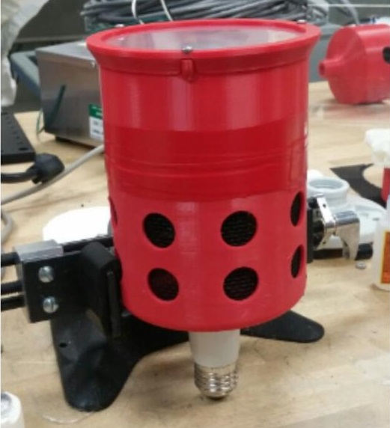
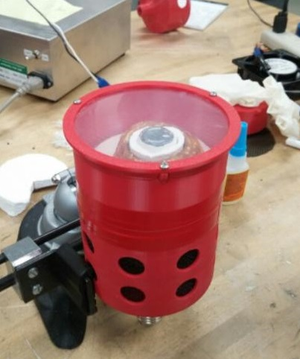
Solid State Evolution: R&D Milestone – May Prototype
Beta Prototype Graphite Foam Infrared Lamp

Slide 22
Solid State Evolution: R&D Milestone – May IR Testing
Notes:
Beta prototype:
running approx 50w, photographed with a Elbit EVS II
(at 6 feet, for approx 6 seconds, reaching 480 degrees)
(at 44 feet, for approx 10 seconds, reaching 480 degrees)
replicate IR from 150w incandescent, particularly 1,300 nm and 1,800 nm and 3,400 nm and 4,200 nm
Significant over-kill.

Slide 23
Solid State Evolution: R&D Milestone – May IR Testing
Notes:
Beta prototype:
running approx 50w, photographed with a Elbit EVS II
(at 6 feet, for approx 6 seconds, reaching 480 degrees)
(at 44 feet, for approx 10 seconds, reaching 480 degrees)
replicate IR from 150w incandescent, particularly 1,300 nm and 1,800 nm and 3,400 nm and 4,200 nm
Significant over-kill.

Slide 24
Solid State Evolution: Fog Chamber IR Tests
Alpha Prototype graphite foam IR emitter tested with:
FLIR A2600sc NIR
CMC Shure Sight I-Series, Mode 2700
Elbit Model EVS II
Performed well between 750nM to 1500nM
Beta Prototype graphite foam IR emitter tested with:
CMC Shure Sight I Series, Model 2700
Elbit Model EVS II
Performed well between 750nM to 5000nM
Notes:
3.2.2.6 Infrared Requirements (LED-PRD-001): “The white steady burning LED light source shall have an integrated infrared power output
greater than 8.2 watts/steradian between 1,300 nm and 1,800 nm or
greater than 3.3 W/sr between 3,400 nm and 4,200 nm.”
Additional work is underway to significantly reduce the size of the module sufficient for use in an MR-16 scale bulb.

Slide 25
Next-Gen MR-16: The Next Evolution
Products must precisely duplicate the visible and ‘usable’ IR photometrics of existing, legacy FAA MR16, at all FAA specified Step levels.
Power-management Design must mitigate PWM-induced prop stroboscopic interaction
Products must significantly improve the energy savings and useful life of existing, legacy FAA MR16 lamps.
Products must have an MR-16 ‘lamp’ form-factor.
Products should ideally require no special ice/snow kit

Slide 26
Next-Gen MR-16: Project Benefits
Power Management
Maximize efficiency
Driver design may incorporate ‘full-On’ IR signature at all dimming levels, if desired
Thermal Performance
Maximize ice and snow mitigation, usually without auxiliary heaters
Integrated Optics
Optimize output (including IR signature, visual CCT, Lumen, etc.)
Minimize glare (duplicate Halogen MR-16 beam and intensity)
Integrated Design
This design will deliver a true, MR16-equivalent ‘bulb’, simplifying any required future maintenance
Pilot Acceptance
Provides cockpit-acceptable visual and EFVS performance

Slide 27
IES Aviation Lighting Committee FALL TECHNOLOGY MEETING 2015
Questions?
SPECTRUM FML

