Slide 1
2015 – IESALC Fall Technology Meeting Business Meeting
Denver Marriott Tech Center
Denver, Colorado
October 18 – 22, 2015

Slide 2
Thank You
All the Presenters!
All the Attendees!
All the Sponsors- $35.5K
IES Committee
Pete Butler, Vice Chair
John Bogart, Treasurer
Billy Schai, Asst. Treasurer
Tara Stewart, Secretary
Frank Barczak, Immediate Past Chair

Slide 3
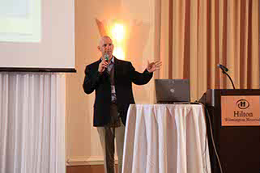
Thank you
Brett Bieberdorf, User Group
Don Gallagher, Government Contacts
Frank Kazienko, Day Show
Gayle Gorman Freeman, Awards
Frank Cassandra, Website / Sponsorships
Dedra Rainey, CEUs

Slide 4
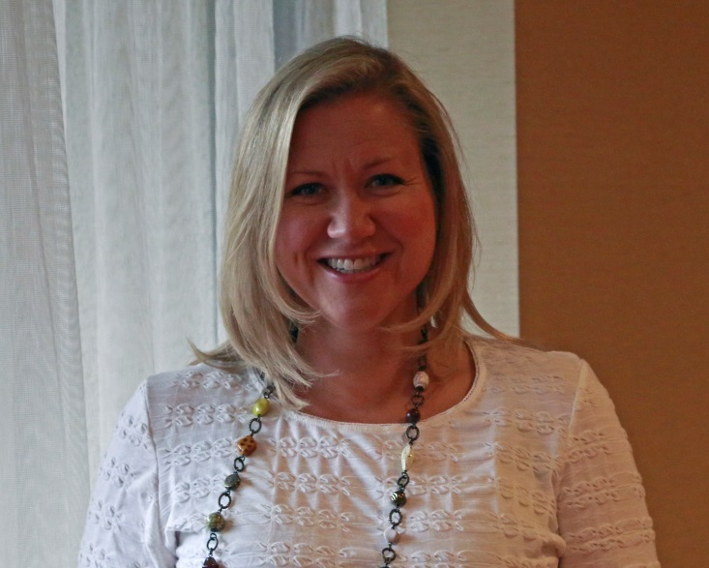
Nominations for the 2016 Board
Pete Butler, Chairman
Tara Stewart, Vice Chairman
John Bogart, Treasurer
Billy Schai, Asst. Treasurer
Faith Adams, Secretary

Slide 5
Treasurers Report
Revenue
Registration - $176.5k
Spouse - $9.5k
Trade Show- $19.8k
Golf- $4.1k
Sponsors- $35.5k
Other Revenue- $14.8k
Total - $260.2k
Costs
Food & Beverage, Marriott
Spouses Tour
Golf
Banquet SAF
Misc. Supplies, Bank Charges, Signs, Trade Show Costs, Spring Meeting, Etc.
Target = $260.2k

Slide 6
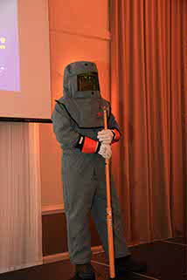
Discussion Items
Survey
Please tell us what you like
Please tell us what can be improved
Paper ideas
Turn in at Podium or take it online at
Survey Monkey

Slide 7
Discussion Items
Banquet Tonight
Meet in North Lobby
Board Buses at 4:00PM, Buses LEAVE at 4:15PM
Papers and Final Attendees List will be online shortly

Slide 8
Unofficial Stats - Attendees
Airports – 42
Manufacturers – 140
Consultants – 77
FAA / Government / Military – 20
Contractors – 12
Academia – 1
TOTAL: 292

Slide 9
Next Meeting
The next Government Contacts Committee will be held at the Holiday Inn Capital in Washington DC this Spring.

Slide 10
2016 IESALC Technology Meeting
Pete Butler
2016 IESALC Chairman

