Slide 1
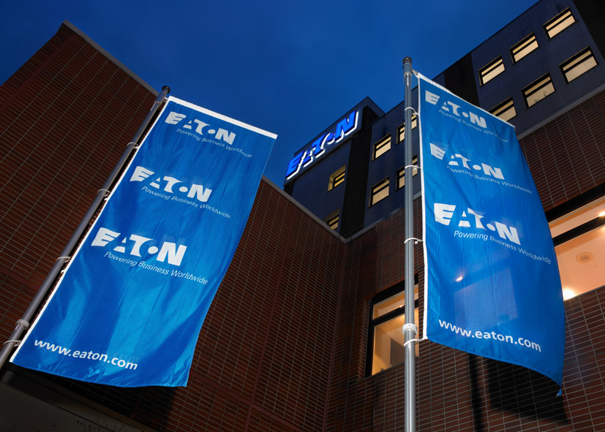
Top Ten Airfield Lighting Maintenance and Management Mistakes
By Phil Rakowski
Notes:
Feel free to give my phone number 860-683-4312 to those attending. I am working on my 34th year in airfield lighting.

Slide 2
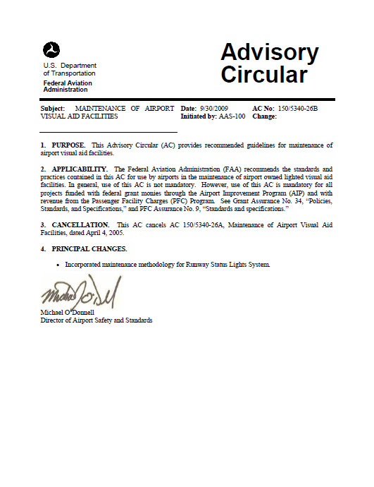
Goal
Review key FAA Advisory Circulars, Equipment Data Pages and materials from our Airfield Maintenance Seminar to show the “TOP TEN” historical mistakes I have seen in the last 30 years in the Airport Lighting Industry.
The Critical FAA Advisory Circulars are as follows:
150/5340-26B Maintenance of Airport
Visual Aid Facilities.
150/5345-53D Airport Lighting Equipment
Certification Program

Slide 3
NUMBER 10:
Purchasing “Equivalent” airfield lighting lamps on the Internet.

Slide 4
Only FAA Approved lamps can be used in FAA Approved Airfield Lighting Fixtures.
FAA approved light fixtures and the lamps that can be used in them are identified in FAA Advisory 150-5345-53D.
Use of lamps not listed in the advisory renders the light fixture “Non Compliant” to FAA specification.
There is no such thing as a “Equivalent” to an FAA approved lamp. Either the lamp is FAA approved or it is not!

Slide 5
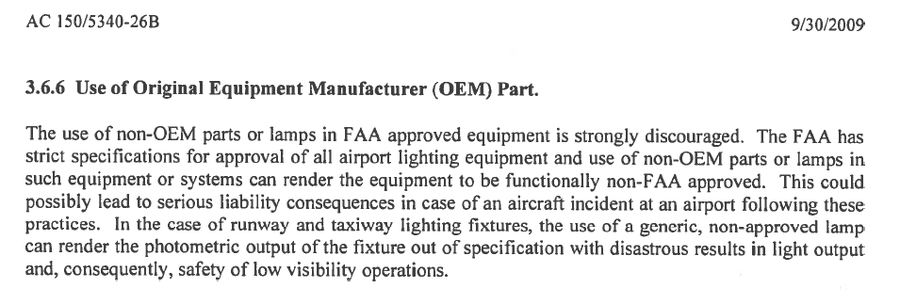
Notes:
This paragraph discusses the issues of introducing non-OEM products into your FAA products. “Liability”

Slide 6
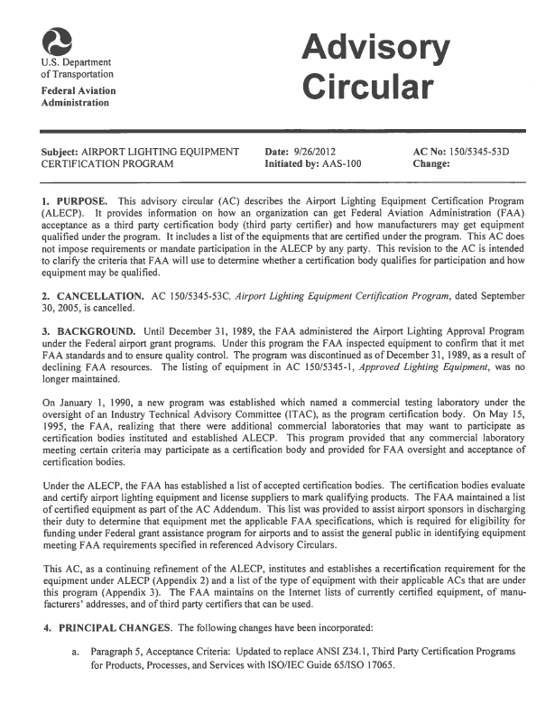
Notes:
This is the FAA Advisory that lists approved products. AC 150/5345-53D This AC is provided in your soft copy thumb drive.

Slide 7
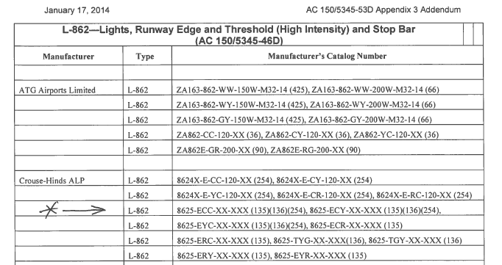
Certified Lamp Example
Notes:
This is the listing of approved products in the Advisory. Note our L- 862 HRLQ Fixture Part number and the lamp number in the brackets, (Lamp Number). This fixture can use lamps #

Slide 8
Certified Lamp Example
Notes:
This the LAMP listing in the advisory appendix 3 addendum that lists the approved lamps.

Slide 9
Number 9:
Re-Lamping or Replacing
Airfield Lighting Fixtures “Hot”.
Notes:
Common Bad practice to re-lamp and replace inset fixture “Hot”

Slide 10
Re-lamping or replacing airfield lighting fixtures while energized is dangerous!
Not only is this practice dangerous, re-lamping or replacing airfield lighting fixtures while energized, pits the contact surfaces of lamp socket or isolation transformer receptacle. Resulting reduced operating life for those components.
Airfield isolation transformers can and do fail on occasion. When the isolation fails, 5000V potential could be available on the lamp socket or elevated or inset fixture body.
Even under normal conditions, the voltage on an open isolation
transformer receptacle can exceed 200 Volts!

Slide 11
Notes:
This paragraph from the advisory describes the dangers to re-lamping and removing energized inset fixtures.

Slide 12
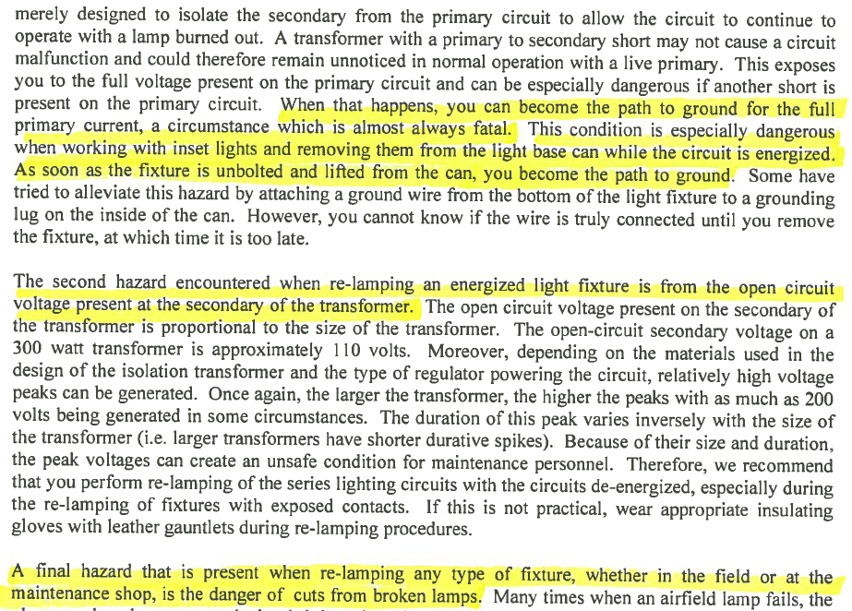
Notes:
This paragraph from the advisory continues describing the dangers to re-lamping and removing energized inset fixtures.
The top high lighted sentences talk about fatal conditions created.

Slide 13
Number 8:
Not having a “Lockout – Tagout” procedure.

Slide 14
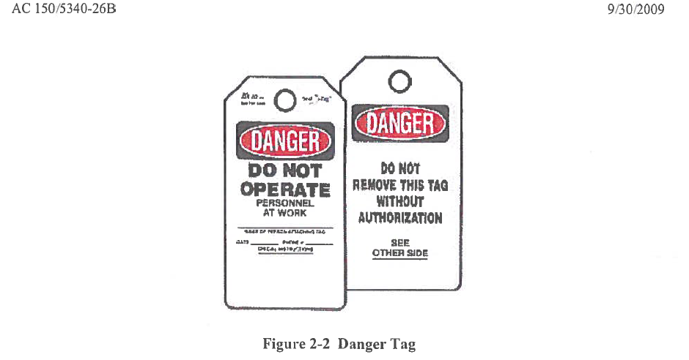
All airport facilities, large and small, should have a viable and strictly enforced “Lockout-Tagout” program.
The unintentional energizing of circuits that are being worked on, is a leading cause of electrical fatalities.

Slide 15
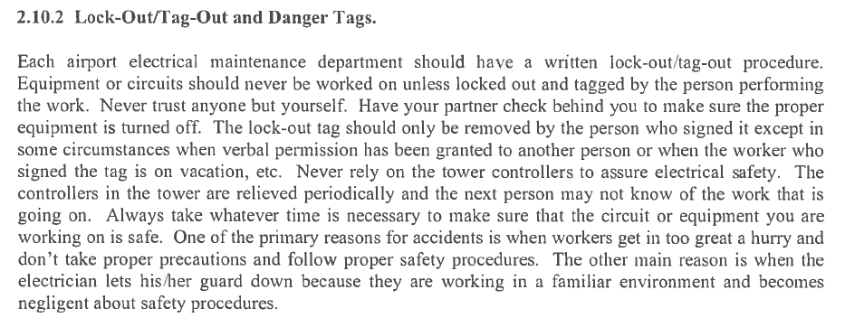

Slide 16
Number 7:
Needlessly Operating Airfield Lighting at the High Intensity.
Notes:
Operating at the maximum 6.6 Amp (or 20 A) brightness level should be avoided when at all possible. Operating at the high brightness level consumes the lamp filaments at the most accelerated rate.

Slide 17
The service life of an airfield lighting lamp is directly related to the average current that flowed through the lamp filament.
Staying out of the maximum brightness level will dramatically improve lamp life.
Operating airfield lighting lamps at 5.5 Amps (B30) vs 6.6 Amps (B100) increases the lamp life by a factor of 10!
Stay out of the high brightness setting unless visibility conditions require it or pilots request it.
Notes:
Think of using the high brightness setting a an “Emergency” condition. Old manual airfield control panels actually had a 15 min delay buzzer that would remind operator that they were in the high setting. This forced the operator to acknowledge the high setting or turn it down.

Slide 18
Do not set the lighting to the maximum setting for “Lamp Checks”. Always use any lower brightness setting.
Work with all those individuals that have access to the airfield brightness controls. Make this a initiative throughout your location.
Airports that have minimized operation in the maximum brightness setting have reduced replacement lamp budget by 66%!
Notes:
Salt Lake city reduced their lamp budget by making a unified effort to stay out of the maximum brightness setting. Year to year comparisons illustrated a 66% reduction in purchased incandescent lamps.

Slide 19
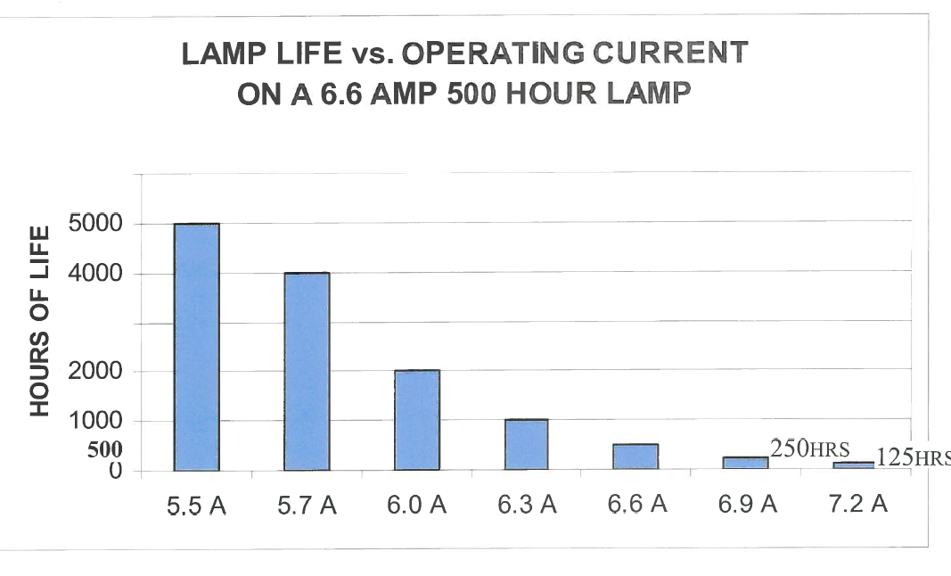
Notes:
Notice the dramatic difference that just 0.3 Amps of filament current makes to the lamp life. This is the 5% Lamp Life Rule that says an increase of 5% above rated lamp current cuts the lamp life in half and a reduction of 5% double the lamp life. This illustrates how closely linked filament current a lamp life are linked.

Slide 20
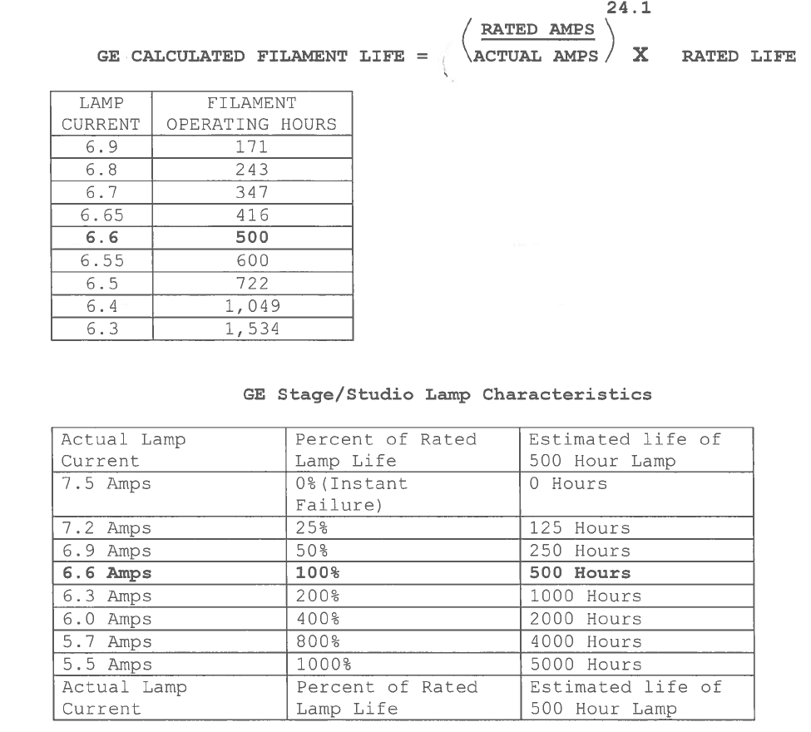
Notes:
These two tables illustrate “GE” data on estimating filament operating hours and percent of rated lamp life as actual lamp current is varied. Notice the dramatic differences as the lamp current varied.

Slide 21
Number 6:
Not Conducting Periodic Maintenance on CCR’s and Circuit Selector Switches

Slide 22
L-828 Constant Current Regulators (CCR’s) and L-847 Circuit Selector Switches are often overlooked for routine maintenance intervals.
The absence of routine maintenance allows preventable circumstances to go unchecked and take down critical airfield lighting equipment.
Spread the work load across the calendar year so all the maintenance isn’t due the same week or month.

Slide 23
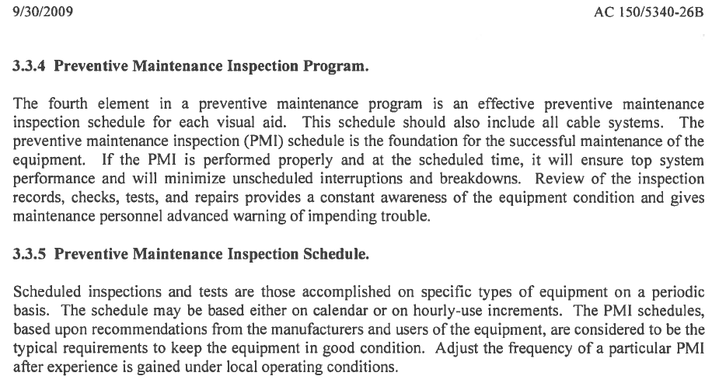

Slide 24
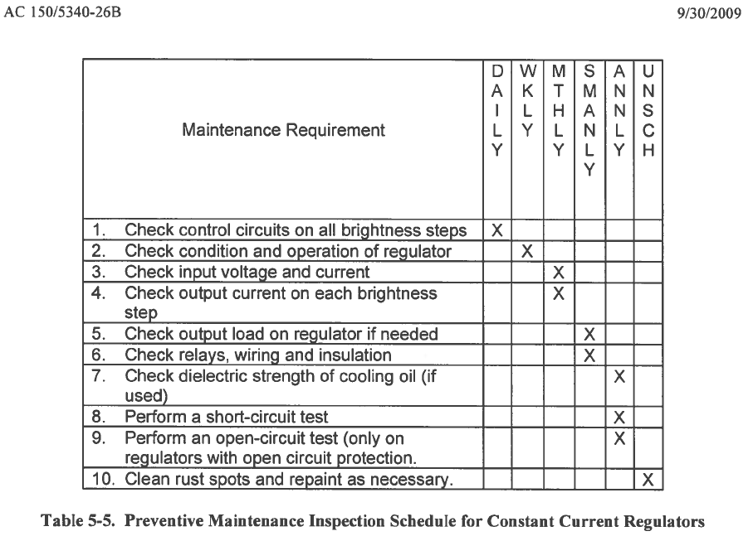
Notes:
The Maintenance Advisory contains maintenance schedules like this one for most airfield lighting components.
Line 6 above is critical, this is the inspection of “Relays, Wiring and Insulation” semiannually. This inspection will catch loose connections and cable compression lugs and detect hot cables by witnessing the discolored insulation. Failure to do this inspection at least annually will often result in CCR failure after several years of neglect.

Slide 25
Number 5:
Using Pneumatic/Electric Wrenches to Mount Inset Fixtures.

Slide 26
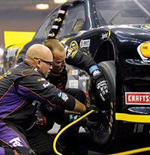
Inset fixture mounting bolts are tightened to very specific torque values.
Pneumatic and electric wrenches are not capable of the precision required and will damage the bolts and threads in the base.
Inset mounting bolts should always be installed using calibrated torque wrenches.
Inset fixtures coming loose creates a extremely hazardous risk to flight safety.
Leave the Pneumatic Wrenches on the Racetrack!

Slide 27
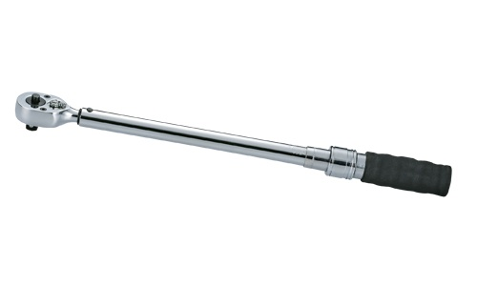

Slide 28
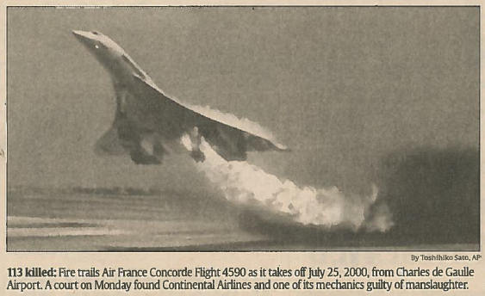
The importance of proper inset fixture mounting and maintenance of the fixtures mounting integrity should not be under estimated.
Notes:
This is a picture of the Concorde moments before it will crash killing all 113 on board. FOD damage to the aircraft doomed the flight.

Slide 29
Number 4:
Not Having Clear and Concise Emergency Procedures in Place.
Notes:
There needs to be a plan in place before the emergency develops.

Slide 30
Many facilities have predefined methods to alert others that you or your location needs an emergency response.
In the event of an emergency personal should be able to get the maximum response by initiating “Action Plans” with key phrases.
For example the phrase “Man Down Emergency” and location “at RW 36 Approach” relayed to the tower. Would roll all available rescue equipment to that location without any further discussion. Because the “Man Down Emergency” phrase initiated a preset and understood “Action Plan”.

Slide 31
Number 3:
Working with Electrical Systems and Not Having CPR and First Responder Training.
Notes:
All individuals working in an electrical maintenance environment should have CPR and Basic First Responder training.

Slide 32
All individuals working in Airport Lighting environments should have CPR and basic first responder training annually.
The distances and logistics involved with airport lighting and actually being out on the airfield will delay responses to the location of the incident.
Electrical rescue equipment should be prominently displayed in all lighting vaults. These are often referred to as “Safety boards”.
Notes:
All individuals working in an electrical maintenance environment should have CPR and Basic First Responder training.

Slide 33
Title
Notes:
All individuals working in an electrical maintenance environment should have CPR and Basic First Responder training.

Slide 34
Number 2:
Not understanding Airfield Light Fixture “Toe-In”, Leveling and Setting angle .

Slide 35
All airfield light fixtures must be oriented correctly to place the fixtures light output in the correct location in relation to the airfield. This is known a fixture “Coverage”
The light output of the lighting fixtures is directed properly by a combination of lenses, levels and in the case of approach lights a digital protractor.
By design many airfield light fixtures have what is called “Toe-In”. Which directs the light output in a predetermined location.
Often fixtures are found to be aimed or toed-in incorrectly during airfield inspections.
Notes:
Maintenance men must be masters of fixture Toe-In.

Slide 36
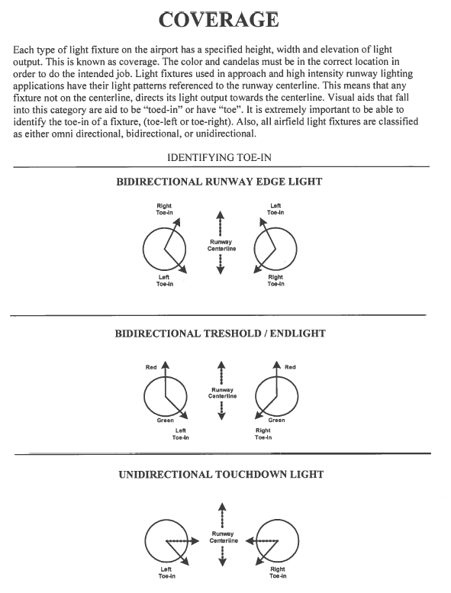

Slide 37
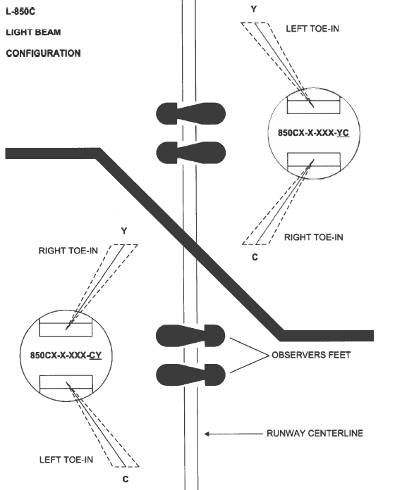
Notes:
Notice that the lower fixture is a Clear – Yellow (CY) and the upper fixture is the Yellow- Clear (YC). Also notice that from the observers point of view it is described as Left color first then the right color second, left to right. Also point out how these fixtures can not be swapped, because the Toed-In beam will be aiming in the wrong location.

Slide 38
Example
Approach Clip (minute 3:00)

Slide 39
Number :1
Airfield Electricians and Maintenance Men are not using the proper TRUE-RMS Ammeters.

Slide 40
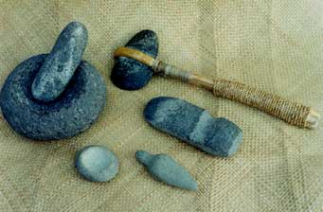
The accurate measurement of airfield current levels can only be done with high quality “True-RMS” Multi-Meter/Ammeters.
Unfortunately these meters are expensive but are necessary to validate, calibrate and troubleshoot airfield lighting systems.
The tolerances in airfield lighting are very tight and require very accurate meters.
Using typical low cost ammeters will introduce large errors and misinformation that will result in incorrectly calibrated or misdiagnosed equipment.
The following four are of acceptable True RMS Multi-Meters and Current Clamp Probes accessories.
Notes:
You have to have a high end True RMS (Root Means Squared) Multi-Meter/Ammeter to work on airfield lighting systems.

Slide 41
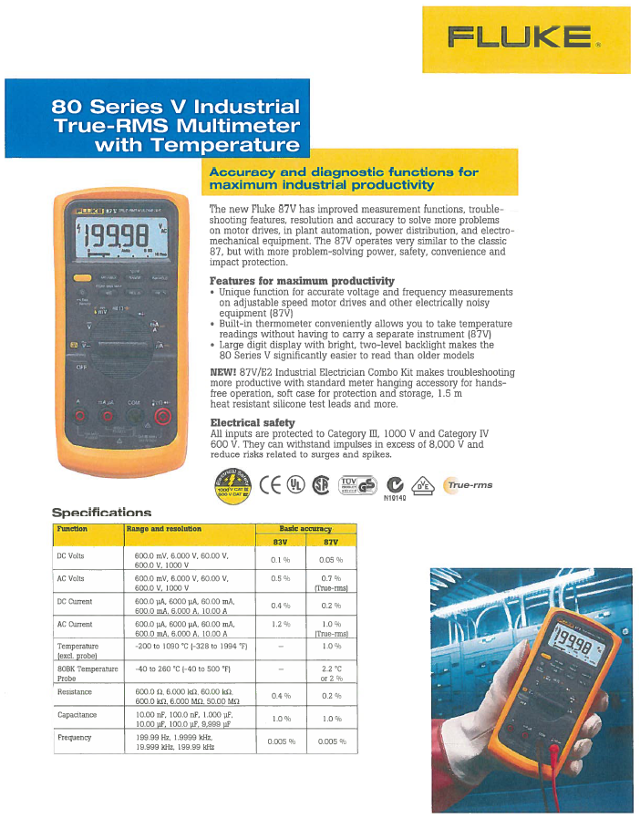
Notes:
These are data pages for acceptable meters and current clamps

Slide 42
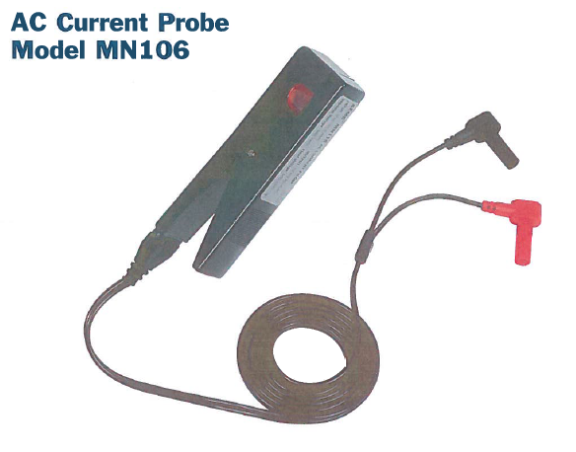
AMEC Brand Current Probe.
Notes:
These are data pages for acceptable meters and current clamps

Slide 43
Notes:
These are data pages for acceptable meters and current clamps

Slide 44
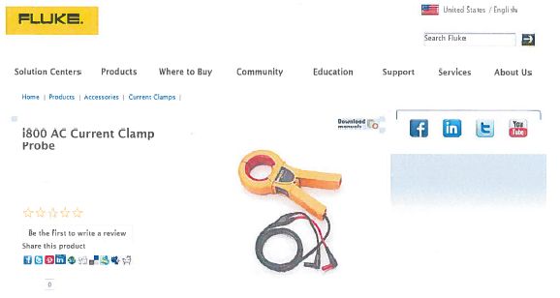
Notes:
These are data pages for acceptable meters and current clamps

