Slide 1
IES-RP-37-15:
Outdoor Lighting for Airport Environments
A New Recommended Practice for the Aviation Community
Authored by:
The IES Aviation Lighting Committee
2017 IESALC Fall Technology Meeting
October 23, 2017
John J. Wujek, PE
Notes:
Welcome to the final day of the Hershsey Airport Conference. This morning I will discuss RP-37. An Illuminating Engineering Society Recommended Practice for airports. How I was developed, its purpose and how to apply it.
Following this presentation will be a case study for lighting presented by Carl Johnson and Jeff May.

Slide 2
Why RP-37?
2005 IES-ALC formed the sub-committee for Recommended Practice to update the old RP-14-87
The IES RP-37 sub-committee is comprised of :
Airports
Manufacturers
Designers
Contractors
Sub-Committee members included:
Richard Larivee, Sub, Chair
Fred Loeffler, Vice –Chair
John Wujek, Secretary
E. Alf
Carl Johnson
H.C. Johnson
H. McKee
A. Seiterle
Irwin Smiley
M. Tebeau
C. Twibell

Slide 3
Why RP-37?
The IES RP-37 was preceded by RP-14-87 from 1987. The old RP provided good general information but………
Where do you put the light on the apron?
How much light on the apron?
What defines the apron?
These questions and the need to educate new personnel to the airport environment with respect to lighting design provided the spark to develop RP-37.

Slide 4
Why RP-37?
Several Airport authorities and organizations have provided some guidance on the location and quantity of lighting at airports over the years.
ICAO
FAA
CASA
IES
All varying standards and recommendations on Lighting…….So,

Slide 5
Why RP-37?
To cover the entire Airport Environment it was evident that the committee needed to provide a Recommended Practice that:
Defined the areas on the airside and landside
Describe the activities and operations that occur in these areas
Describe and define the visual issues specific to the airport environment
Define the design criteria for the airport areas
Provide reference to other standards, RPs, Aviation Authority documents

Slide 6
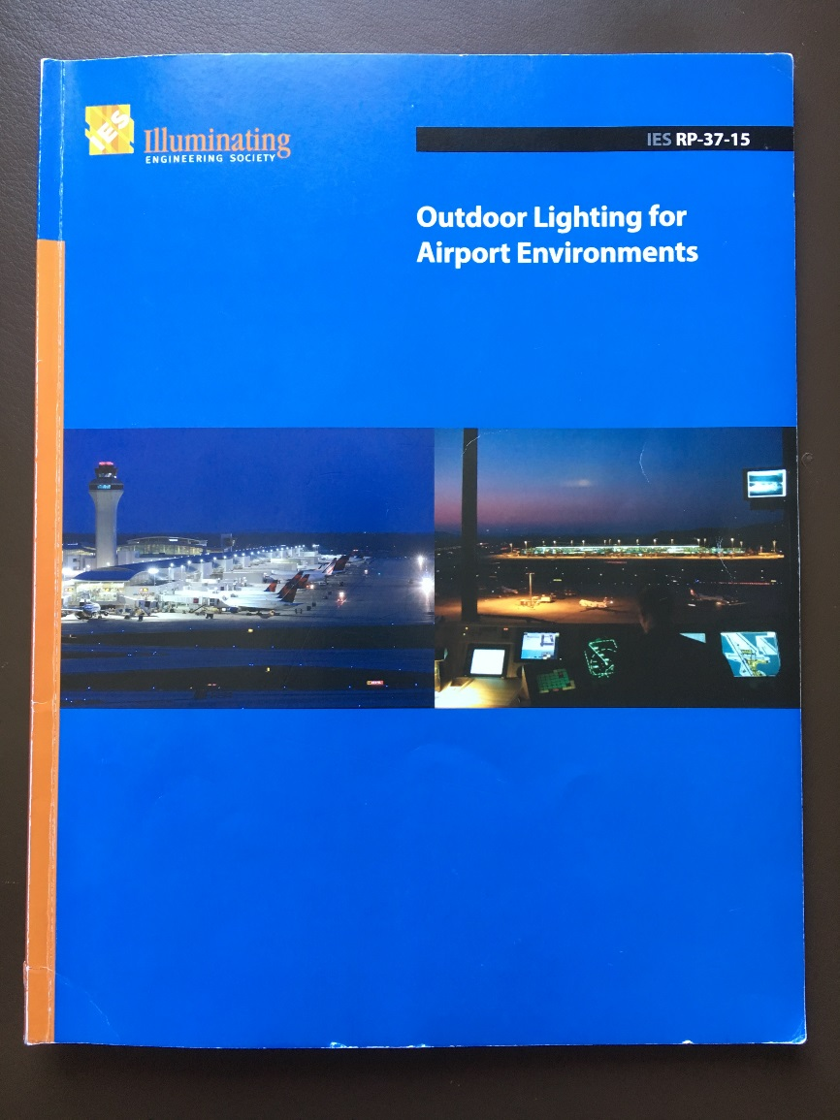
Contents
The content for the RP includes:
Introduction
Characteristics of Airport Areas
Visual Issues
Design Criteria
Essential Safety and Security Lighting
Environmental Considerations
Annexes A through I for supporting
Documentation
Lets get started!

Slide 7
1.0 Introduction
This IES Recommended Practice provides guidance to provide an adequate and safe lighted environment while emphasizing restrictions, regulations and best practices for:
Aircraft servicing and apron areas
Aircraft support services, i.e., fueling, cargo, baggage load/unload
Passenger loading and unloading
Roadways
Vehicle parking facilities
Pedestrian walkways
The RP Encompasses the entire Airport Environment, both Airside and Landside.

Slide 8
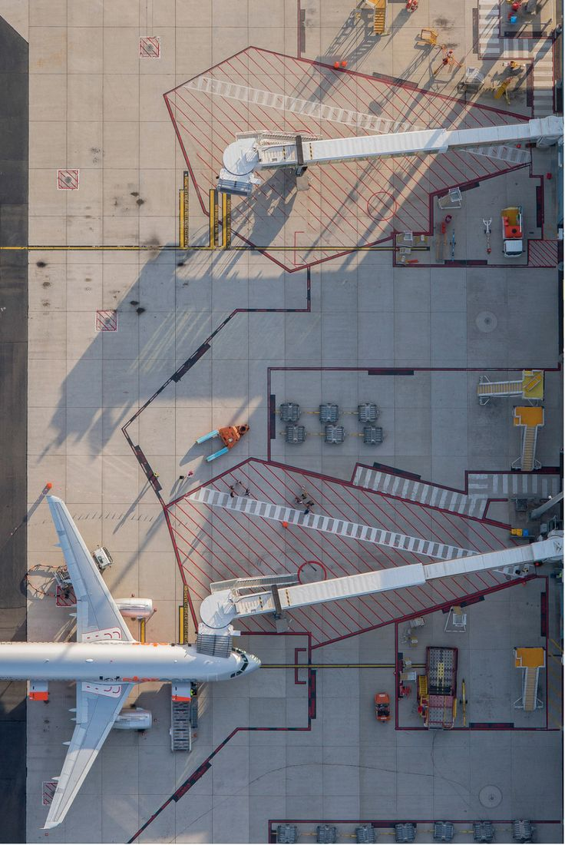
2.0 Characteristics of Airport Areas
This section defines the activities and operations on the Airport:
Aprons; Commercial (Air Carrier), Cargo, Hangar, General Aviation
Aircraft Stand
Aircraft parked position
Aircraft service area
Other Airside Areas
De-icing Facilities
Fuel Facilities
GSE Storage Areas
Engine Run-up / Test Areas

Slide 9
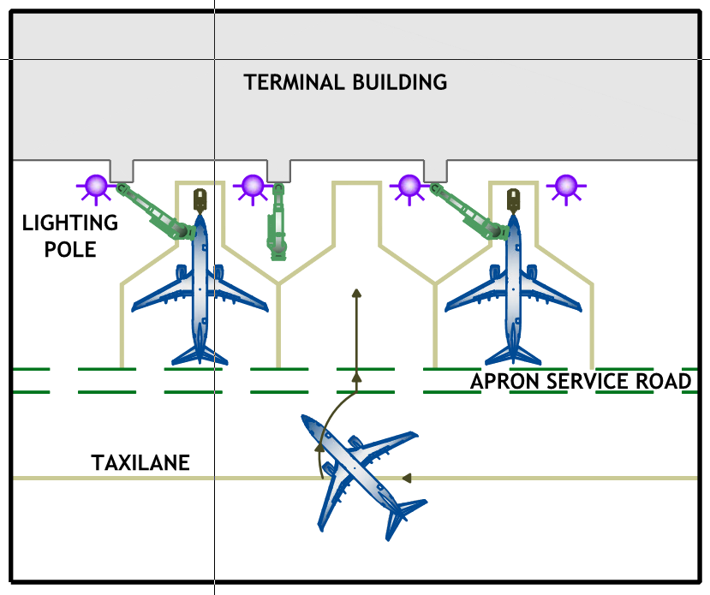
2.0 Characteristics of Airport Areas
Aprons:
General Layout shown
Parking aircraft
Aircraft support
Servicing
Loading / Unloading operations

Slide 10
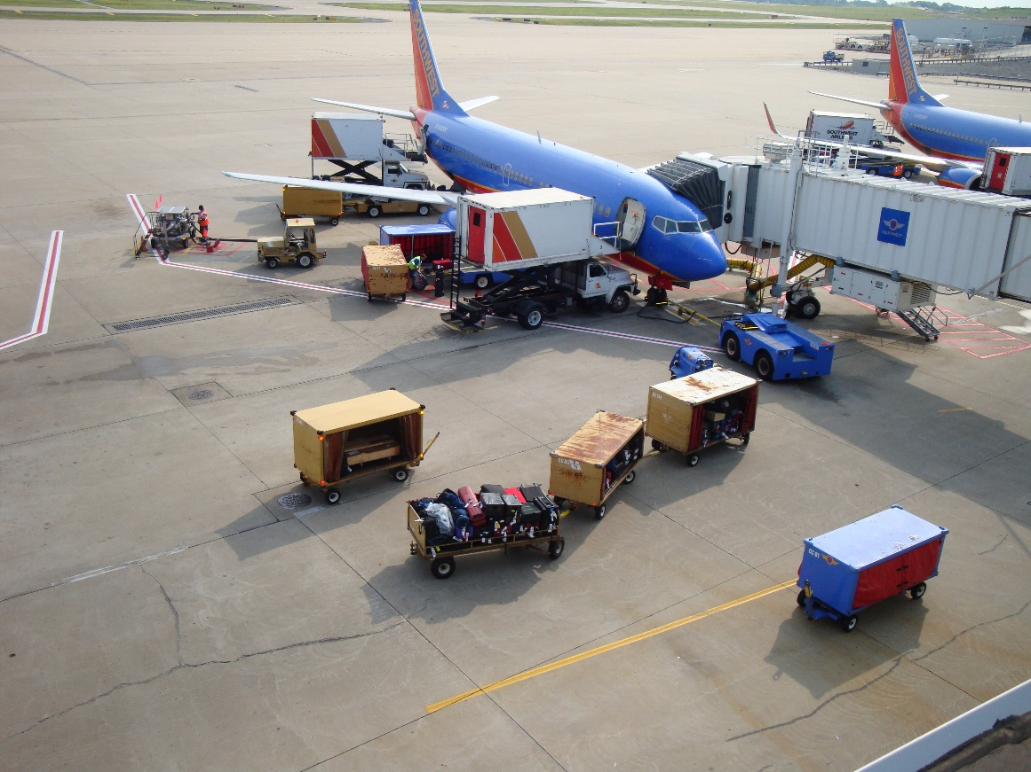
2.0 Characteristics of Airport Areas
Aprons: Commercial (Air Carrier)
Park aircraft
Board & Deplane passengers
Baggage, Fueling
Aircraft servicing

Slide 11
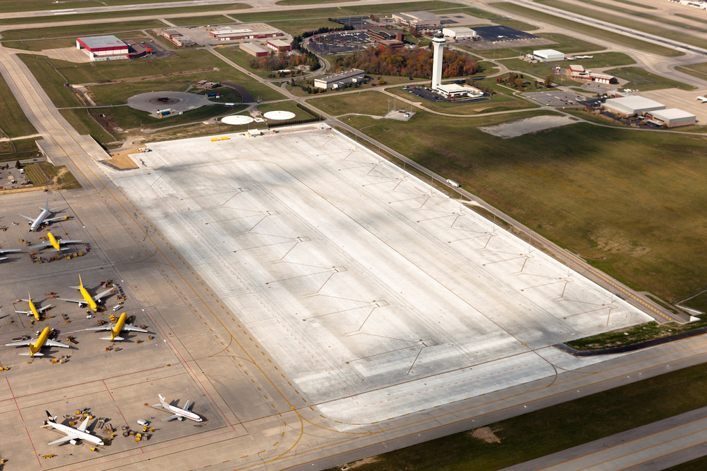
2.0 Characteristics of Airport Areas
Aprons: Cargo Apron
Parked cargo aircraft
Load/Unload Cargo
Fuel Aircraft

Slide 12
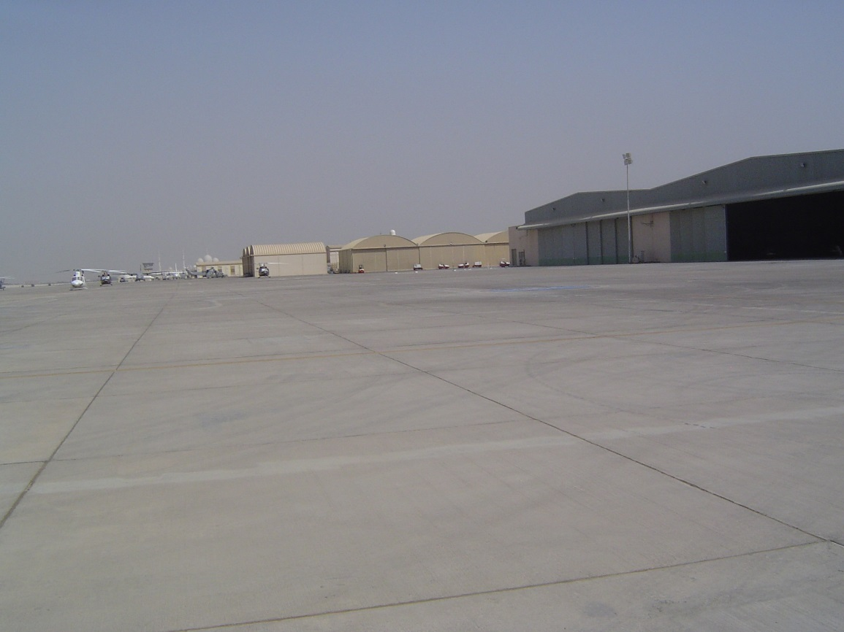
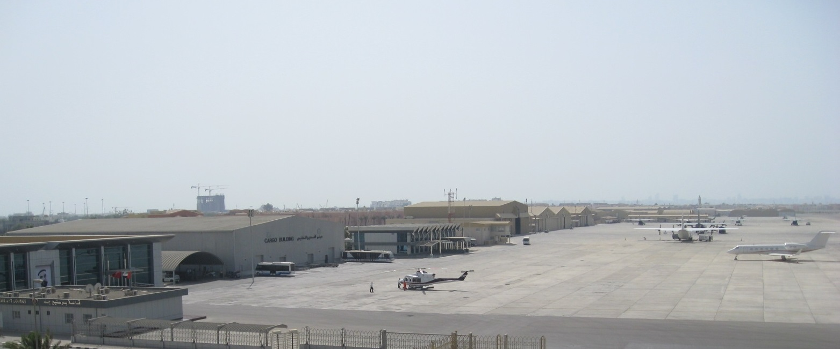
2.0 Characteristics of Airport Areas
Aprons: Hangar Apron
Temporary parked aircraft
Maintenance checks
Can be a diverse Aircraft mix
Various aircraft types

Slide 13
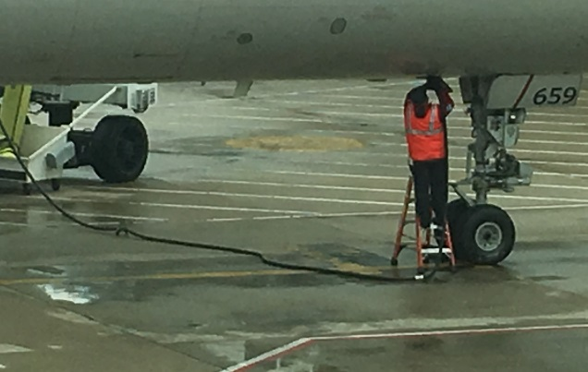
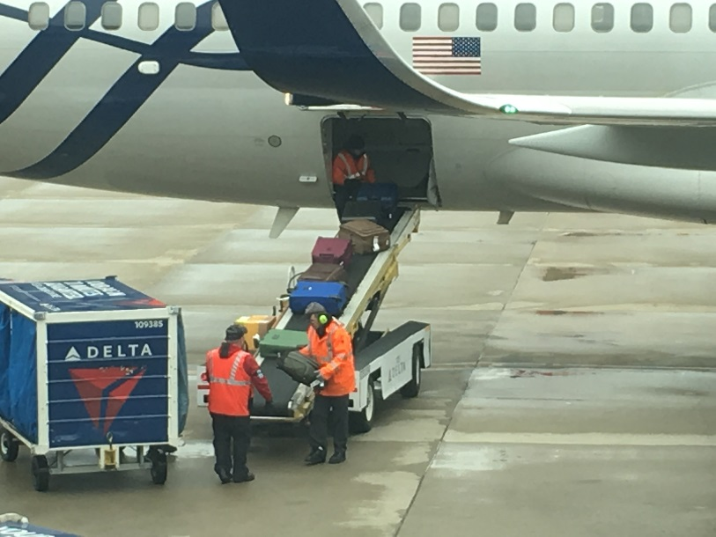
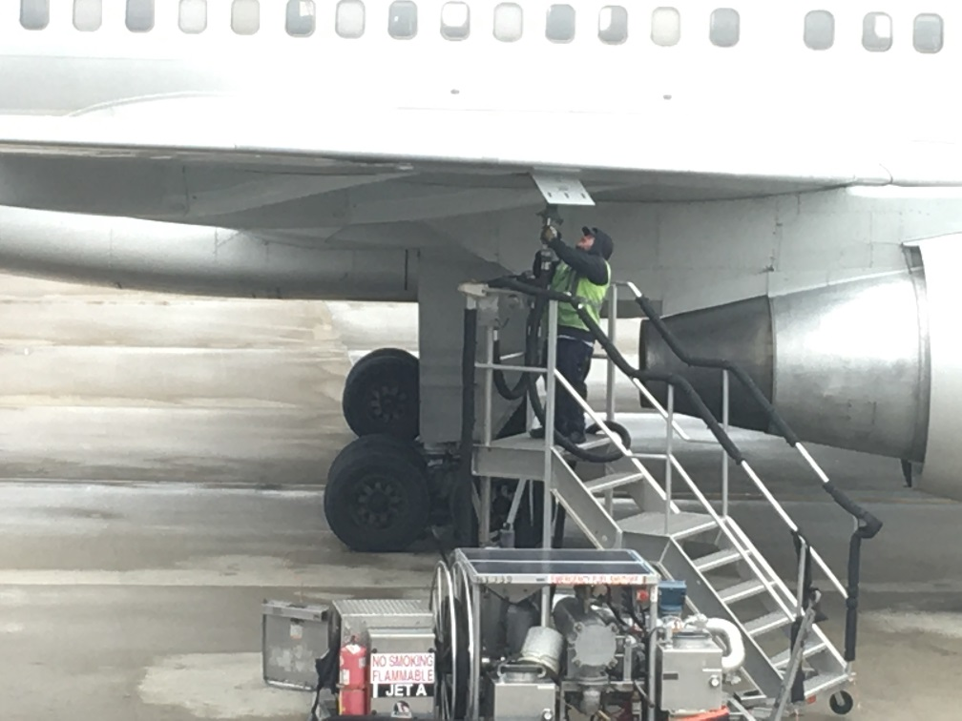
2.0 Characteristics of Airport Areas
Within the Apron, is an Aircraft Stand:
Very Busy, Many functions

Slide 14
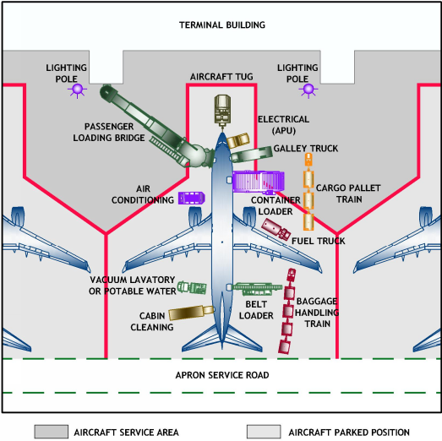
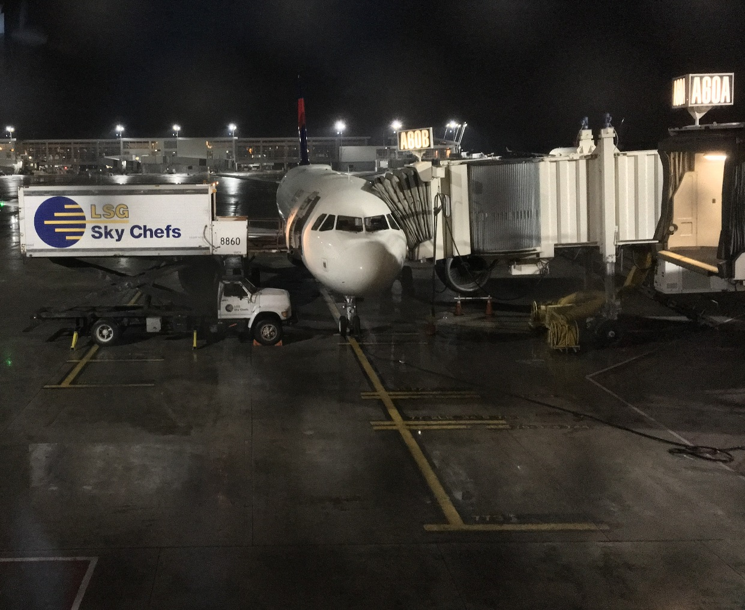
2.0 Characteristics of Airport Areas
Within the Apron, is an Aircraft Stand:
Very Busy, Many functions

Slide 15
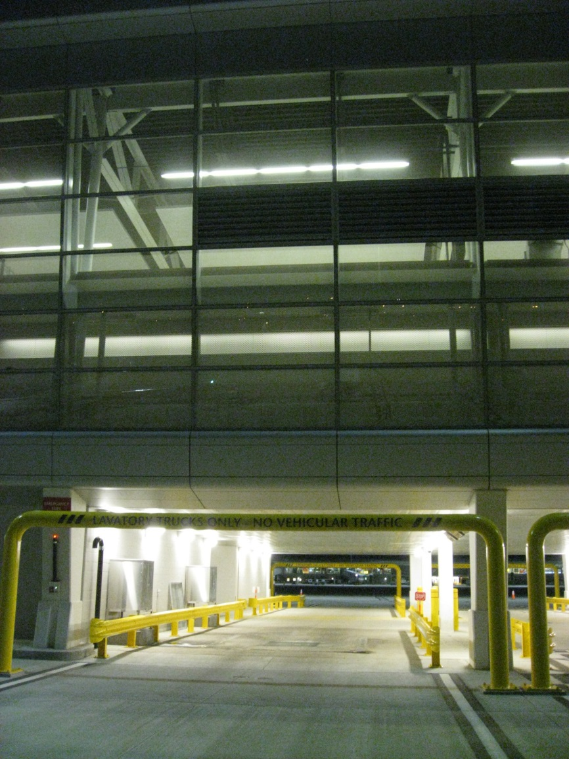
2.0 Characteristics of Airport Areas
This section defines the activities and operations on the Airport:
Landside Areas
Departure / Arrival Areas
Walkways from Parking to Terminal
Roadway systems surrounding the Terminal
Directional signage
Secured access points
Surface parking and garage parking
Tunnel lighting, under taxiways
Laser sensitive areas

Slide 16
3.0 Visual Issues
Visual issues will be unique to each airport based on operations and layout of the airport.
Visual issues include how lighting design for a task impacts other areas:
The designer must consider the effect of the lighting design on the:
Airport Geometry
Control Tower
Pilot
Pedestrian and Driver Conflicts (landside)
Security

Slide 17
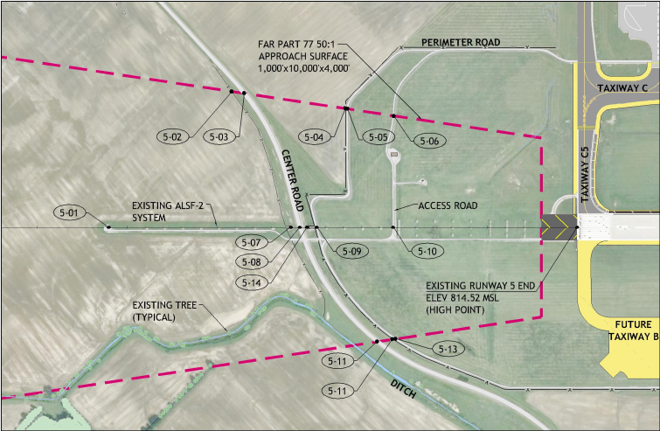
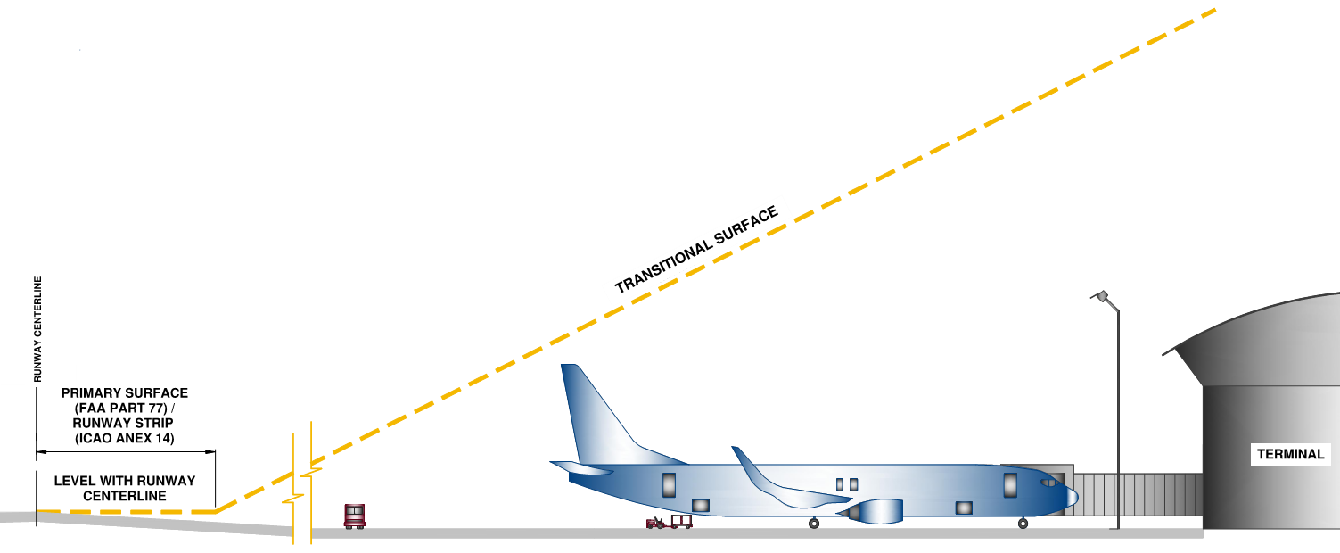
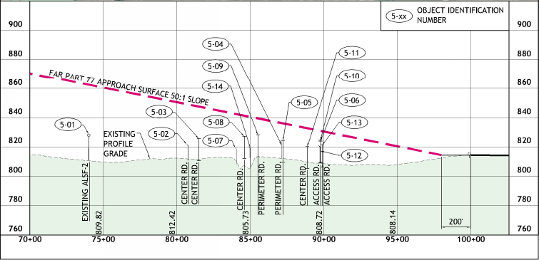
3.0 Visual Issues
Visual issues for Airport Geometry:
Approach Areas
Height restrictions
Part 77 surfaces

Slide 18
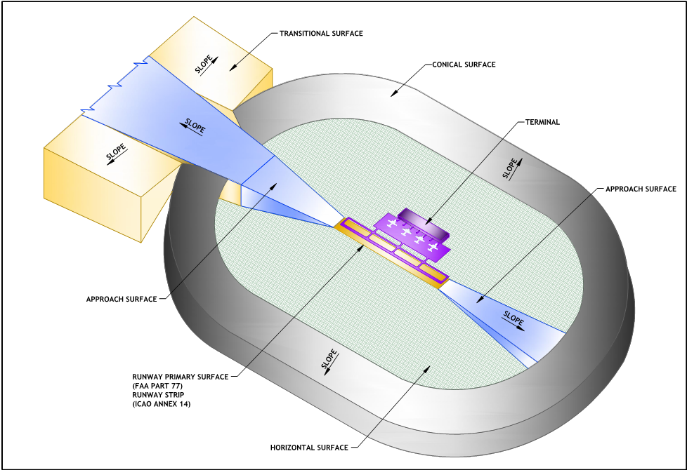
3.0 Visual Issues
Visual issues based on Airport Geometry:
Imaginary Surfaces
Approach Slopes

Slide 19
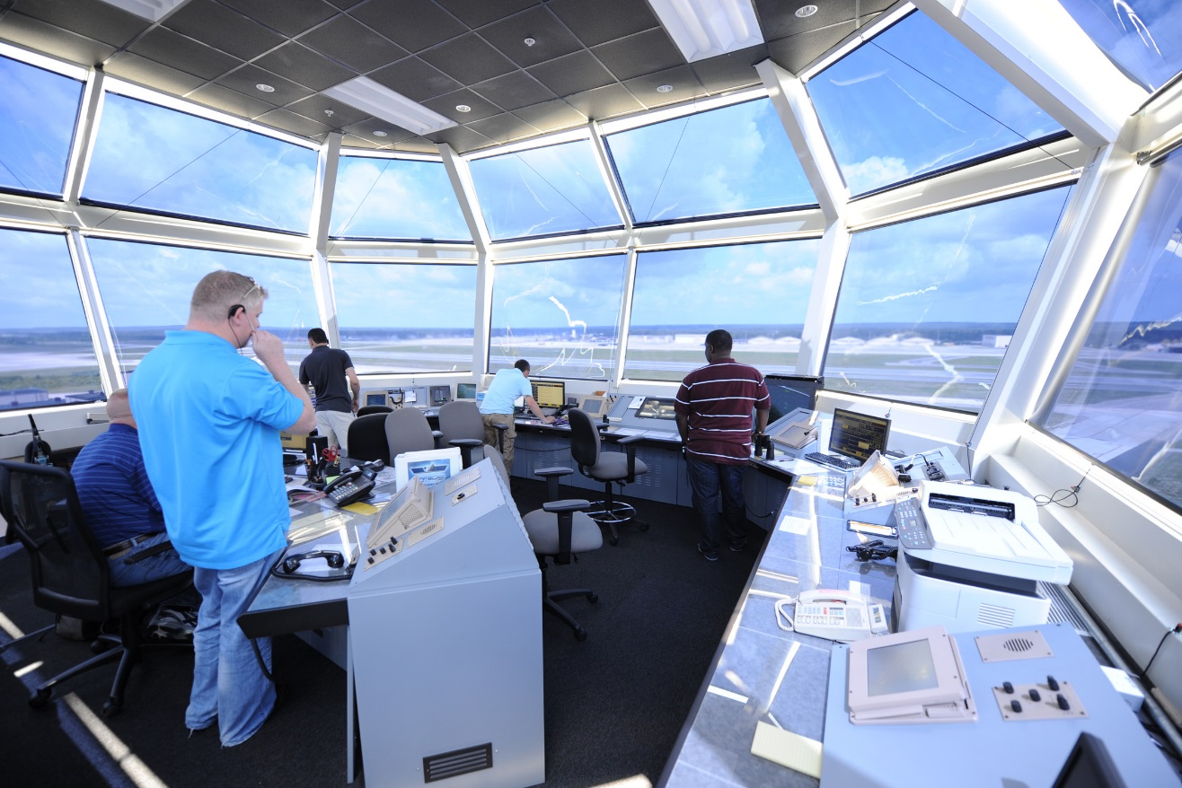
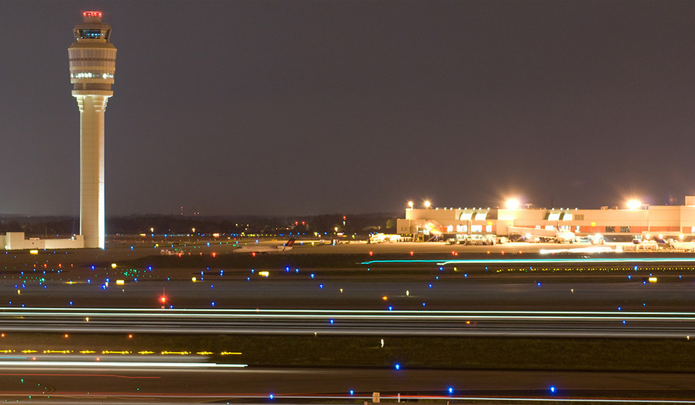
3.0 Visual Issues
Visual issues for Control Tower:
Reflected light can be troublesome
Controllers vision should not be impaired by glare or obtrusive light

Slide 20
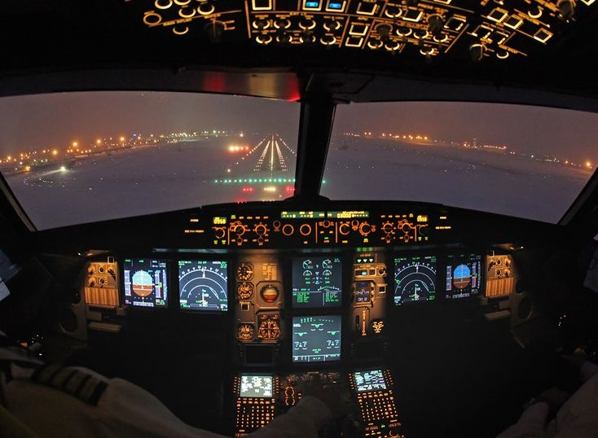
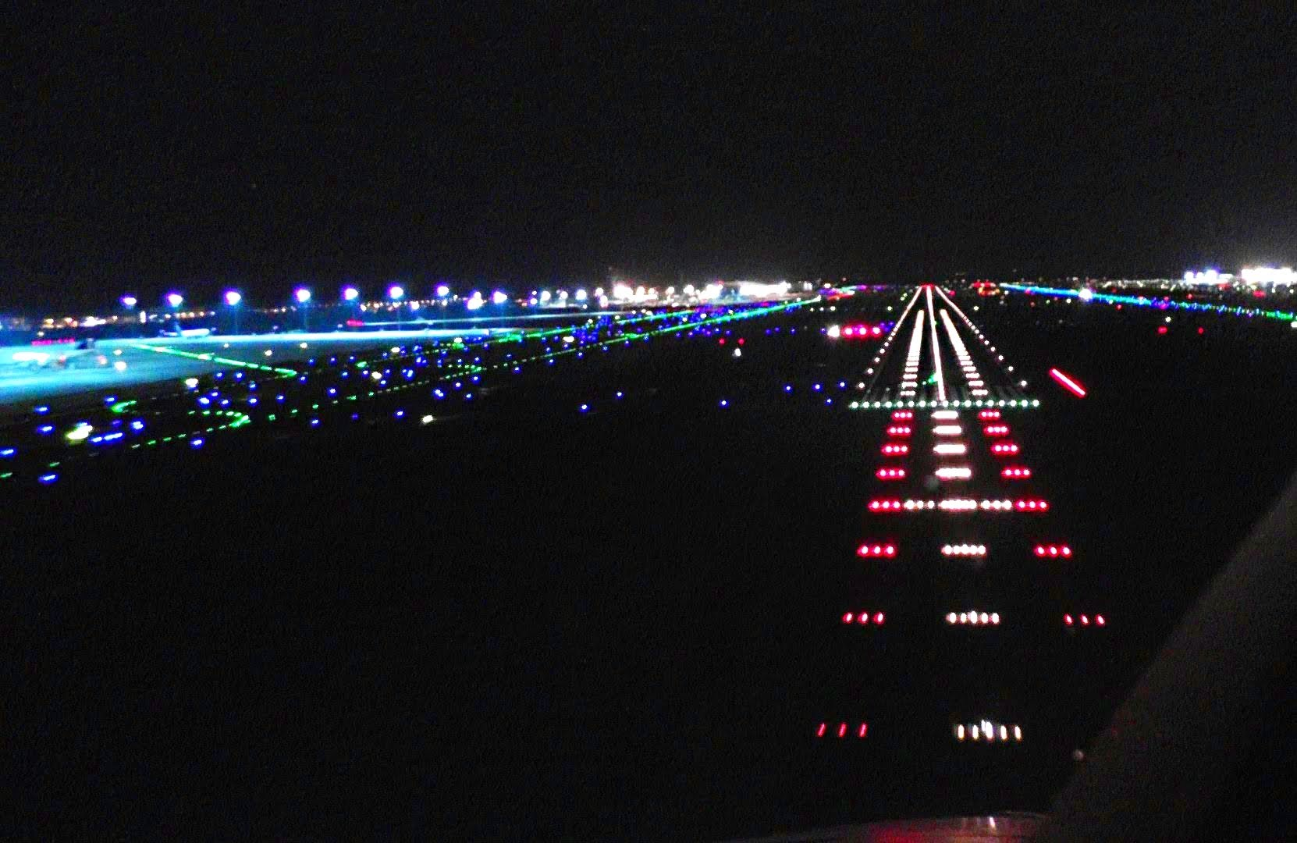
3.0 Visual Issues
Visual issues for Pilot:
Approaching Airport
Rollout

Slide 21
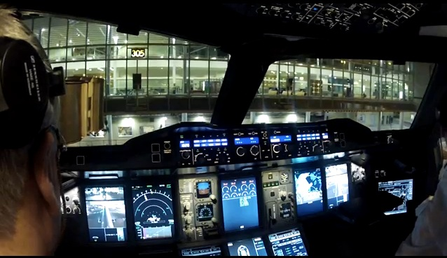
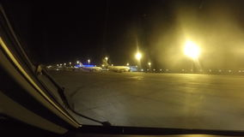
3.0 Visual Issues
Visual issues for Pilot:
Taxiing
Parking the Aircraft

Slide 22
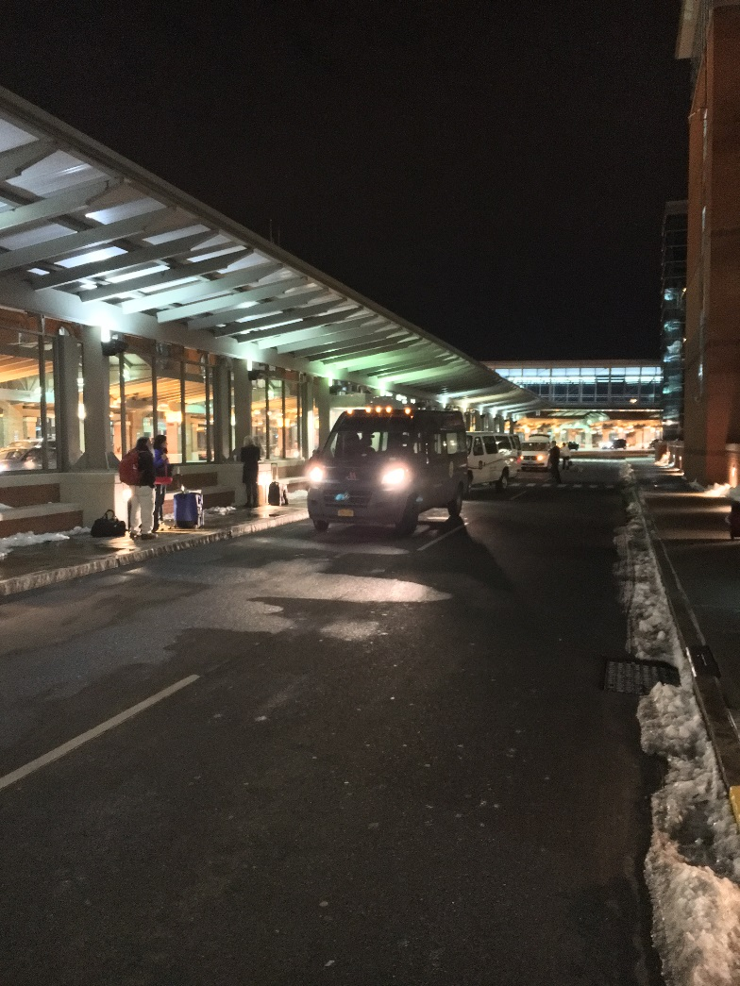
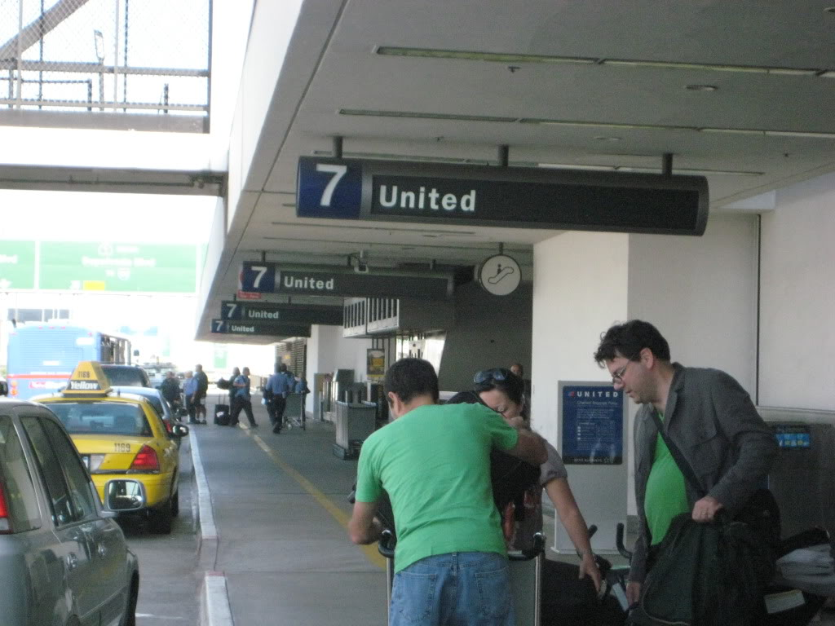
3.0 Visual Issues
Visual issues for Pedestrian and Driver Conflicts (landside):
Magnitude of pedestrian flow is related to quantity of aircraft arrivals and departures
Moving and stopped vehicles in the areas
Distractions and unfamiliarity with services

Slide 23
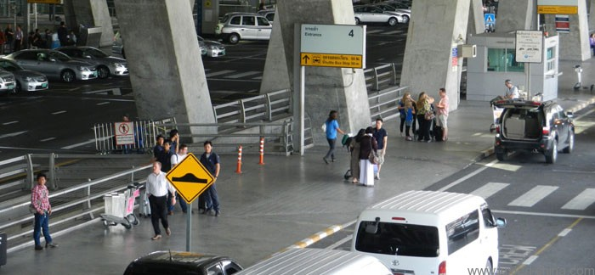
3.0 Visual Issues
Visual issues for Pedestrian and Driver Conflicts (landside):
This section adapted from ANSI/IES RP-8-14 American National Standard for Roadway Lighting
All airport “Pedestrian Conflict Areas”
are classified as “High”

Slide 24
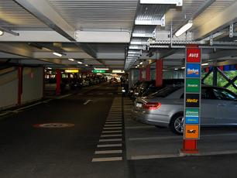
3.0 Visual Issues
Visual issues for Security (both airside and landside):
Maintain security of aircraft, aircraft perimeter
Consider walkways and pathways
Parking areas
Keep line of sight open
No hard corners/hiding places
Tree canopies min. of 7ft above ground
Softscape landscapes kept low
Safety enhanced when people can see
each other beyond 30 feet
(fight or flee)

Slide 25
4.0 Design Criteria
This section contains design information for lighting the airport environment. Design Criteria is provided in Tabular form to be used with guidance provided.
Codes, ordinances or mandates can supersede any of the IES criteria.
This document does not supersede any government regulation, safety criteria or the Authority Having Jurisdiction
Guidance Documents exist and designer should be familiar with:
FAA AC 150/5300-13 Airport Design
ICAO Aerodrome Manuals
European Standards
Lighting design should avoid objectional spill light and glare

Slide 26
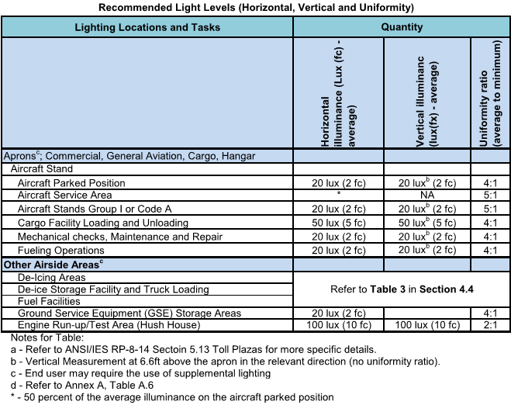
4.0 Design Criteria
Design Criteria Tables:
Table 1-Airside Areas
Aprons
De-Icing areas
This document does not supersede any government regulation, safety criteria or the Authority

Slide 27
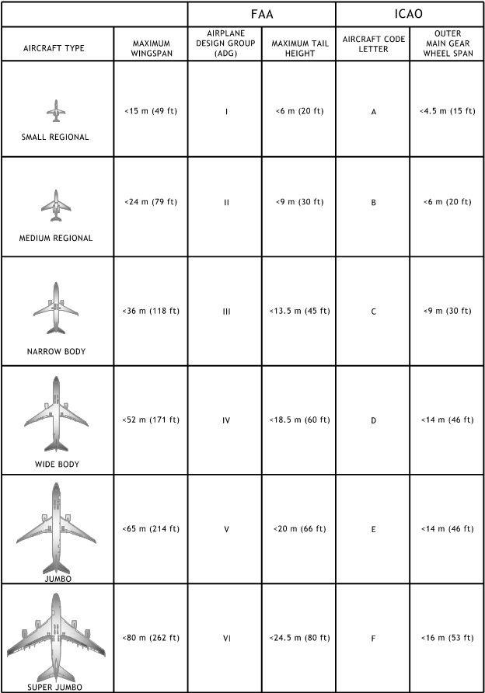
4.0 Design Criteria
Design Criteria:
Aircraft stands can accommodate multiple aircraft types, dimensional data and pilots eye position

Slide 28
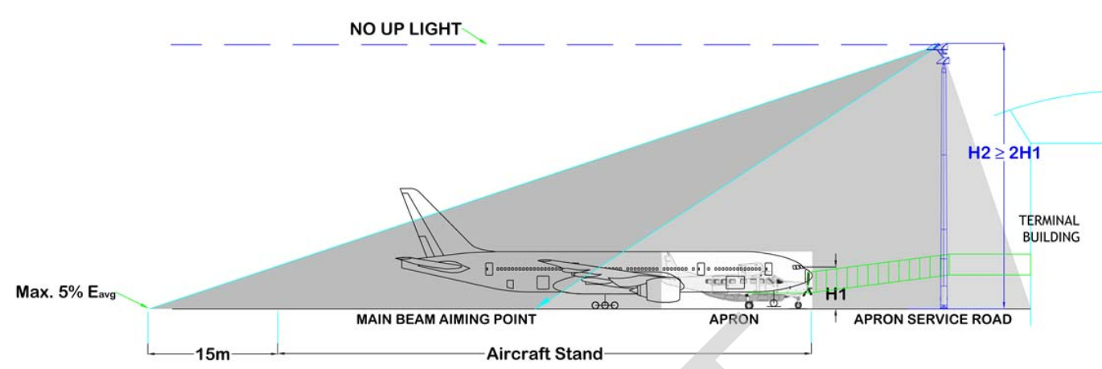
4.0 Design Criteria
Design of poles should minimize glare to pilot. Mounting height of luminaires should be at least 2X the pilots eye position height for largest design aircraft at the stand.

Slide 29
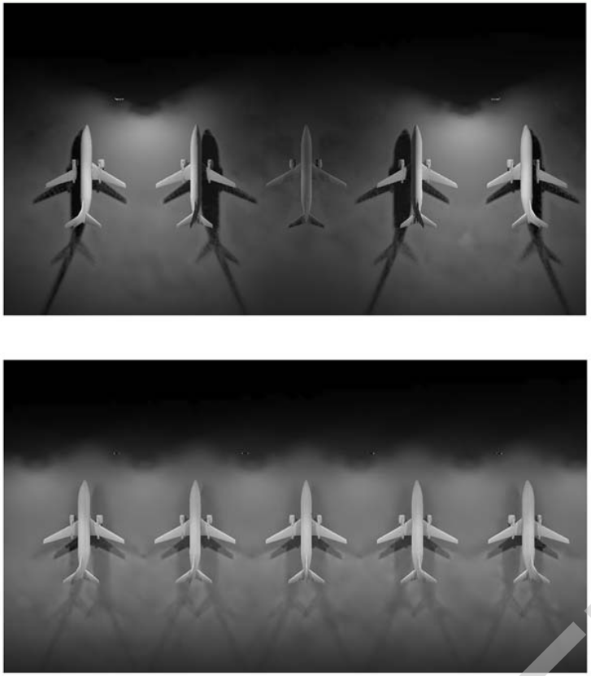
4.0 Design Criteria
Design:
Provide light directed to aircraft stand from two or more directions
Shadows on the apron can impact efficiencies, goal is to minimize shadows
Shadows are created when light poles are omitted between aircraft

Slide 30
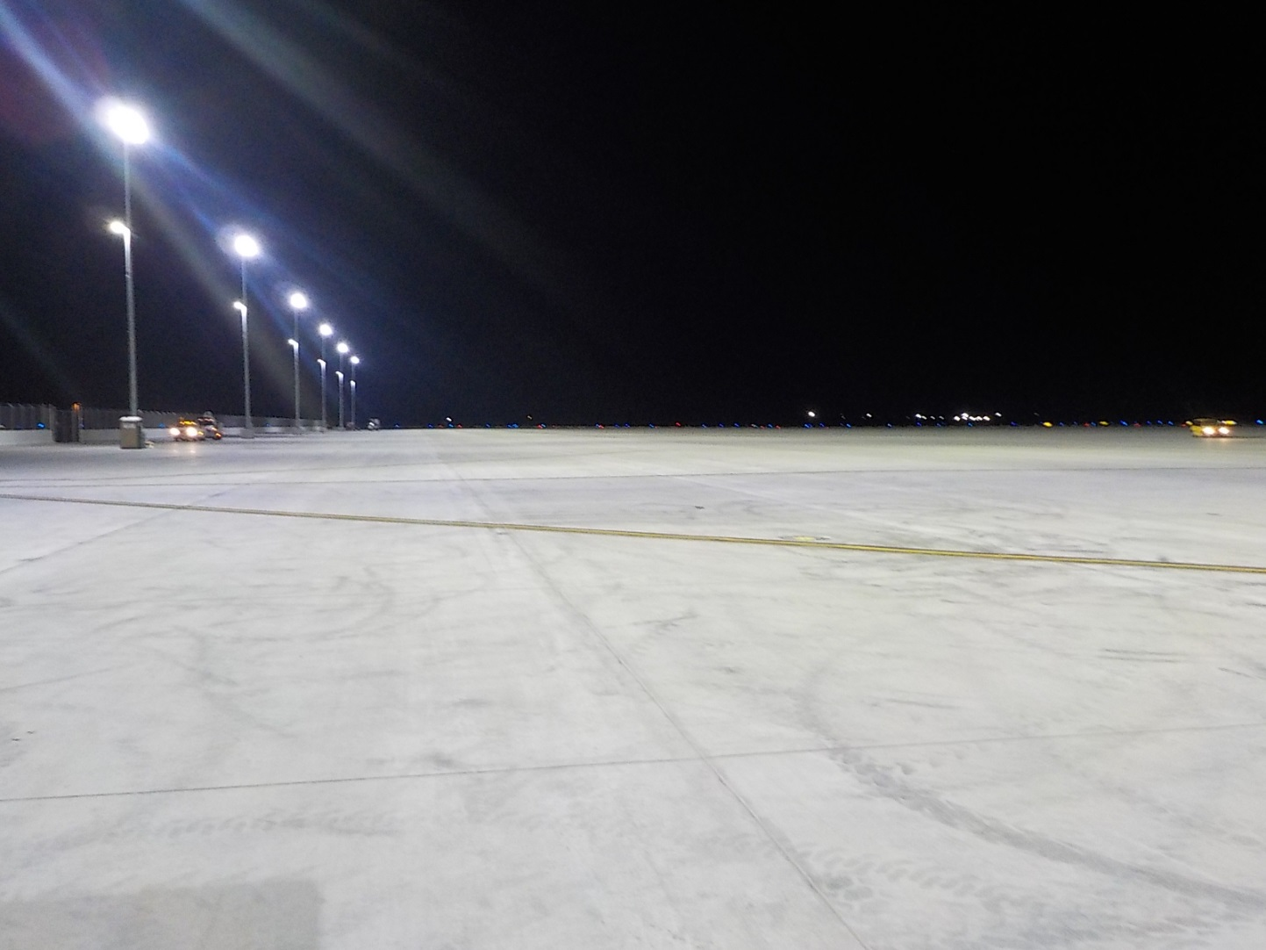
4.0 Design Criteria
Good lighting design:
Provides uniform lighting on apron
Decreases shadow on apron
Minimizes pilot glare
Light is cutoff outside the area to be illuminated

Slide 31
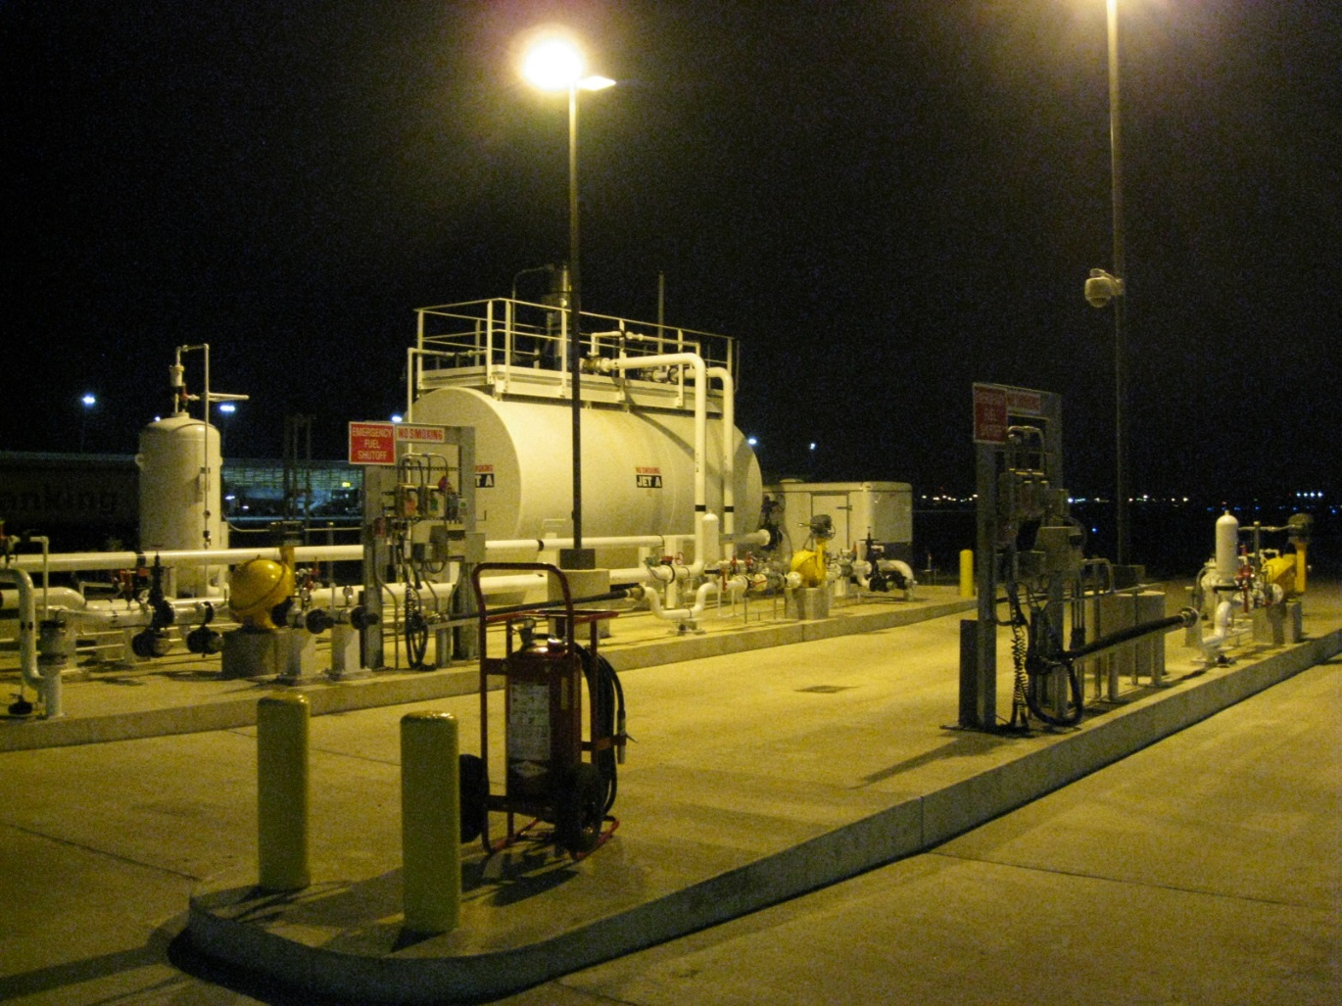
4.0 Design Criteria
Fueling areas:
Provides increased lighting for loading areas
Minimizes glare
Light is cutoff outside the area to be illuminated

Slide 32
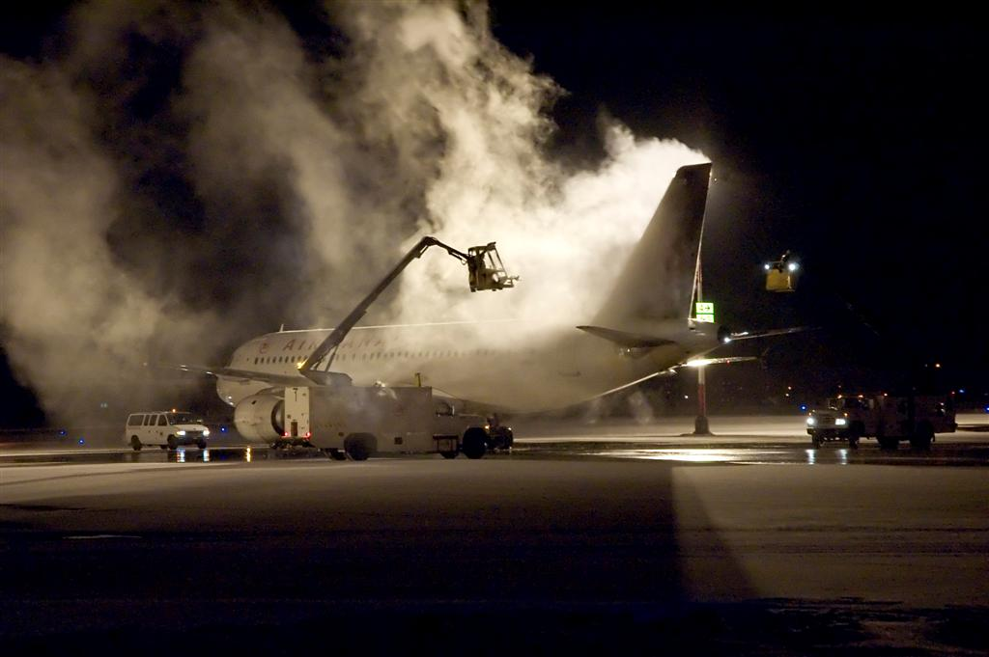
4.0 Design Criteria
De-icing areas can be located at locations where poles cannot be installed, use of equipment mounted lights may be required.
Coordinate deicing operations:
Surface height restrictions
Approach aircraft
Glare from deice operations

Slide 33
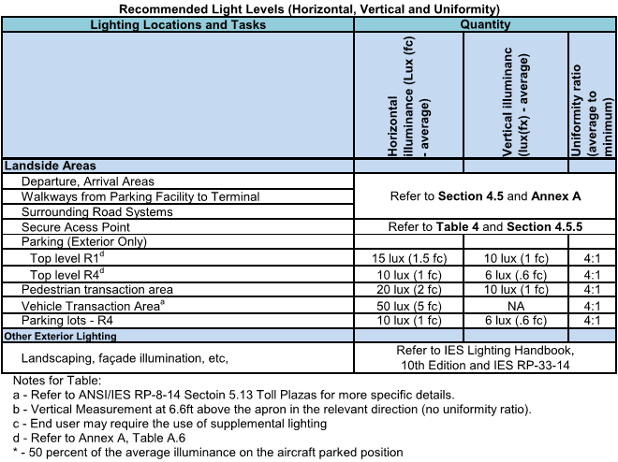
4.0 Design Criteria
Design Criteria Tables:
Table 1- Landside Areas
Departures/arrivals
Road systems
Parking
Landscaped areas
Vechicle tolls

Slide 34
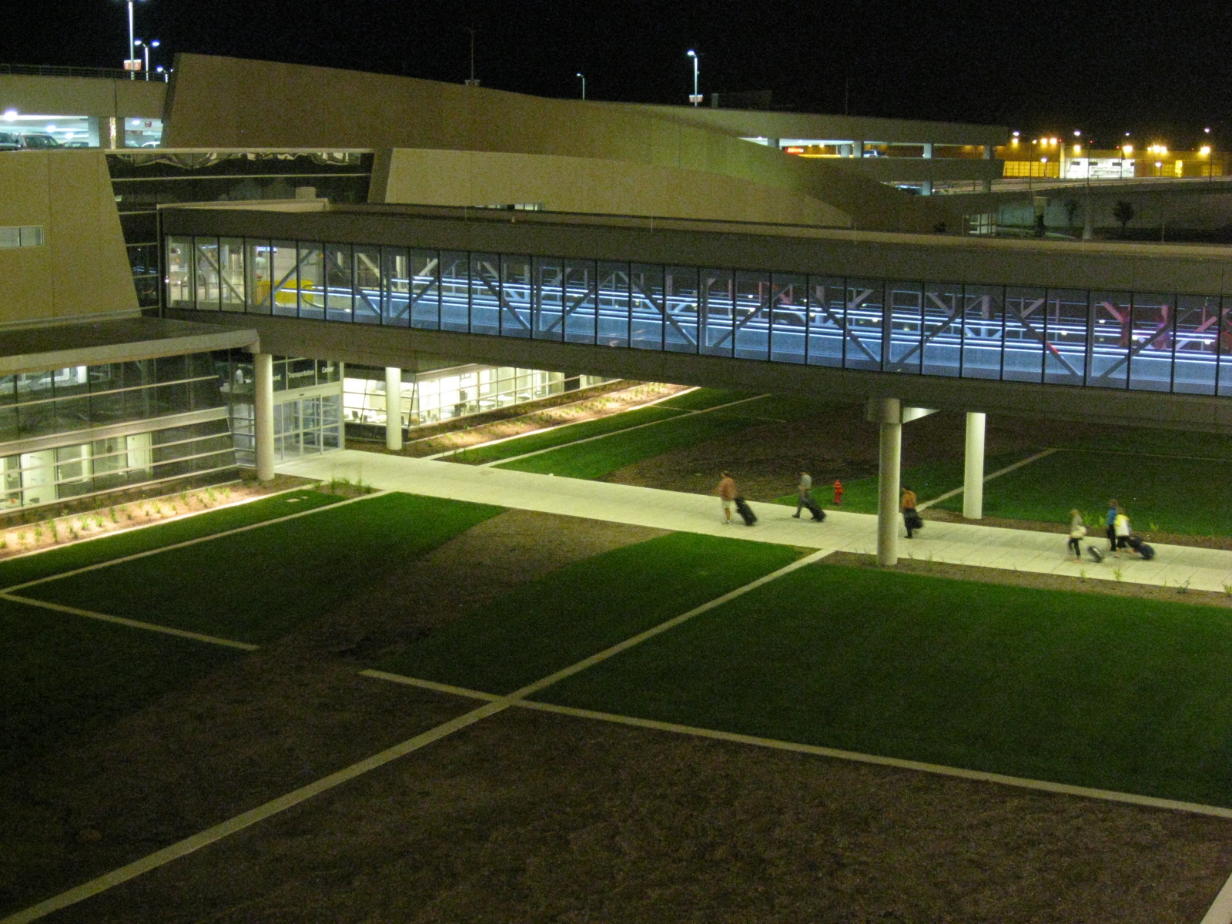
4.0 Design Criteria
Design Criteria:
Landside Areas
Walkways to/from parking and rental cars
Illuminate area at least 30 feet around the walkway for security and visual recognition

Slide 35
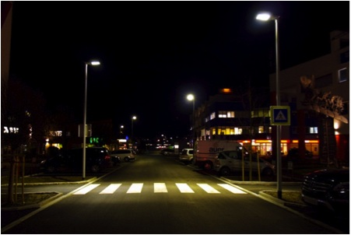
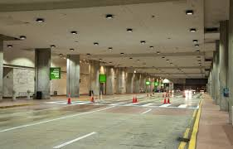
4.0 Design Criteria
Design Criteria:
Roadside / Pedestrian Areas
Conflict areas to be well illuminated
Provide luminance of pedestrians for vehicle drivers to visually acquire
Avoid lights only at cross walks

Slide 36
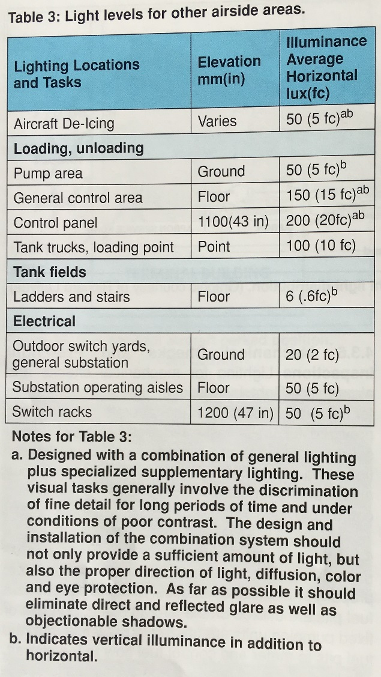
4.0 Design Criteria
Design Criteria Tables:
Other Airside Areas, Industrial areas / Activities on and around an airport are provided in Table 3.
De-icing vehicle loading areas
Loading and unloading of fuels and liquids
Fuel tank fields
Outdoor electrical equipment

Slide 37
5.0 Essential Safety and Security Lighting
This section contains information for safety and security lighting for public egress and safety. Guidance is given for:
Exit Lighting – To Apron Area from the Building
Coordinate with the facilities back-up power system:
Design duration of power outage
Available power capacity of the standby systems
Restrike time of HID lamps
Review with AHJ

Slide 38
6.0 Environmental Conditions
This section contains guidance for lighting design with respect for the environment, neighbors and future generations.
Light Pollution and Light Trespass
Boundary Limit Concepts
Lighting Ordinances
Outdoor Site-Lighting Performance (OSP)
Leadership in Energy and Environmental Design (LEED)
Ecological Aspects
Sustainable Development

Slide 39
Annex A through I
Annex information is provided from other documents to provide lighting criteria and information:
Values for Roadways, pedestrian areas
Field Measurements and performance criteria
Maintenance Considerations
Lighting Equipment
Economic Considerations
Aviation Glossary
References
Suggested Reading
Lighting Terms
last

Slide 40
Questions or Comments?
Richard Larivée, P.E., Chair IES RP-37
IESALC recommended practices subcommittee email:
practices@iesalc.org

