Slide 1
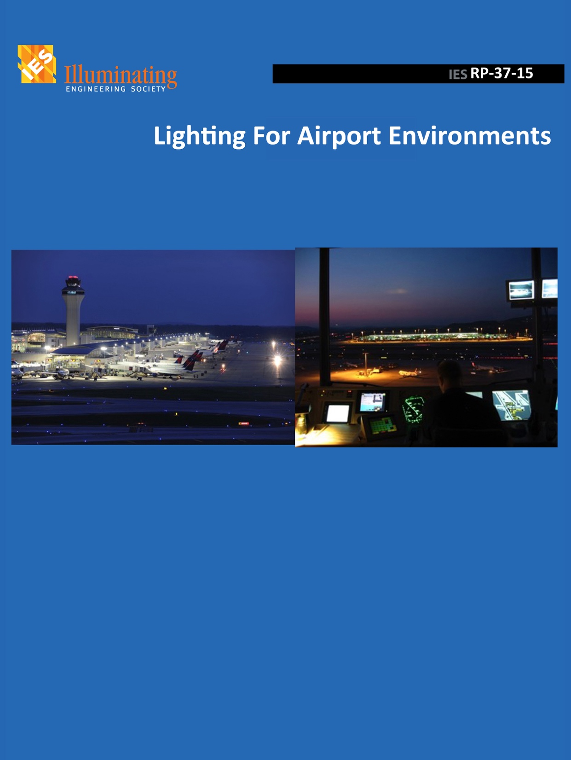
IES-RP-37 Outdoor Lighting in the Airport Environment last update before publication!
Outdoor
2015 IES ALC Fall
Technology Meeting
Marriott Denver Tech Center
Denver, Colorado
Available soon!

Slide 2
IES RP-37 last update before publication
Committee Members – THANKS!
Heather C. Johnson, Hubbell
Heather Mckee, Denver International Airport
Eduard Alf, Transport Canada
Carl Johnson, Avcon
Gilles Lauzière, Urbex
Fred Loeffler, CHA – Vice chair
Alfred Seiterle, Aeroplan Engineering
Irwin Smiley, AECOM
Mike Tebeau, Lambert-St Louis International Airport
Craig Twibell, RS&H
John Wujek, HNTB - Secretary
Richard Larivée, Avia Rupta Solutions - Chair

Slide 3
IES RP-37 last update before publication
Scope
Outdoor lighting in the airport environment includes aircraft stands and apron areas, roadways, vehicular parking facilities, passenger loading and unloading areas and pedestrian walkways.
The recommendations included in this IES RP provide guidance for lighting of these areas while emphasizing the restrictions, regulations, and best practices for safe movement of aircraft.
Excluding AGL and heliport areas.

Slide 4
IES RP-37 last update before publication
History
1987 - Publication of RP-14 and RP-17 (1968)
2008 - RP-37 subcommittee kick-off
2010 - Document sent for comments at IES TRC – 40% draft
2011 - 80% draft sent out for comments +- 200 comments
2011 - Graphics and pictures set up.
2012-2013 - Successive update and modification of document.
2014 - Document ready for review and final graphic
2015 - Committee reviews (sub-committee, main committee, IES technical review committee, IES board)

Slide 5
IES RP-37 last update before publication
Table of content of RP
Introduction
Characteristics of Airport Areas
Visual Issues
Design Criteria
Essential Safety and Security Lighting
Environmental Conditions
Annexes
Luminance and illuminance for roadway lighting
Field measurement
Maintenance
Economics
Lighting Equipment
Glossary, Reference and Additional Reading

Slide 6
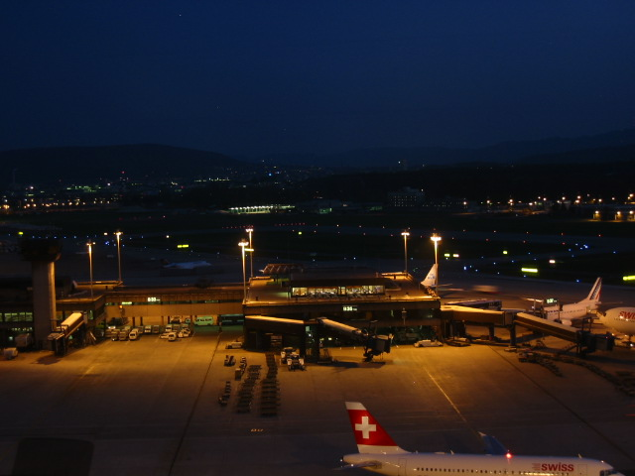
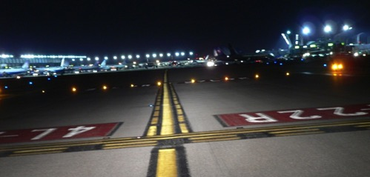
IES RP-37 last update before publication
Visual Issues
Airport control towers
Visibility throughout airfield and landside
Line of sight (pole and luminaire)
Obtrusive light
Pilot
Approaching the airport
Rollout & Taxiing
Parking
Zurich airport
From Alfred Seiterle.
Captain Mike Maas Regional Airport Safety Coordinator Air Line Pilots Association, Intl.

Slide 7
IES RP-37 last update before publication
Design Criteria
Aviation Special Conditions
Glare reduces visibility when low mounted luminaires are aimed out and away from the area to be lit.
Unnecessary or unwanted glare is minimized by using higher fixture mounting height position and steeper aiming angles, thereby putting the light where it is needed, while reducing the visibility of the actual light source, and minimizing light pollution and light trespass.

Slide 8
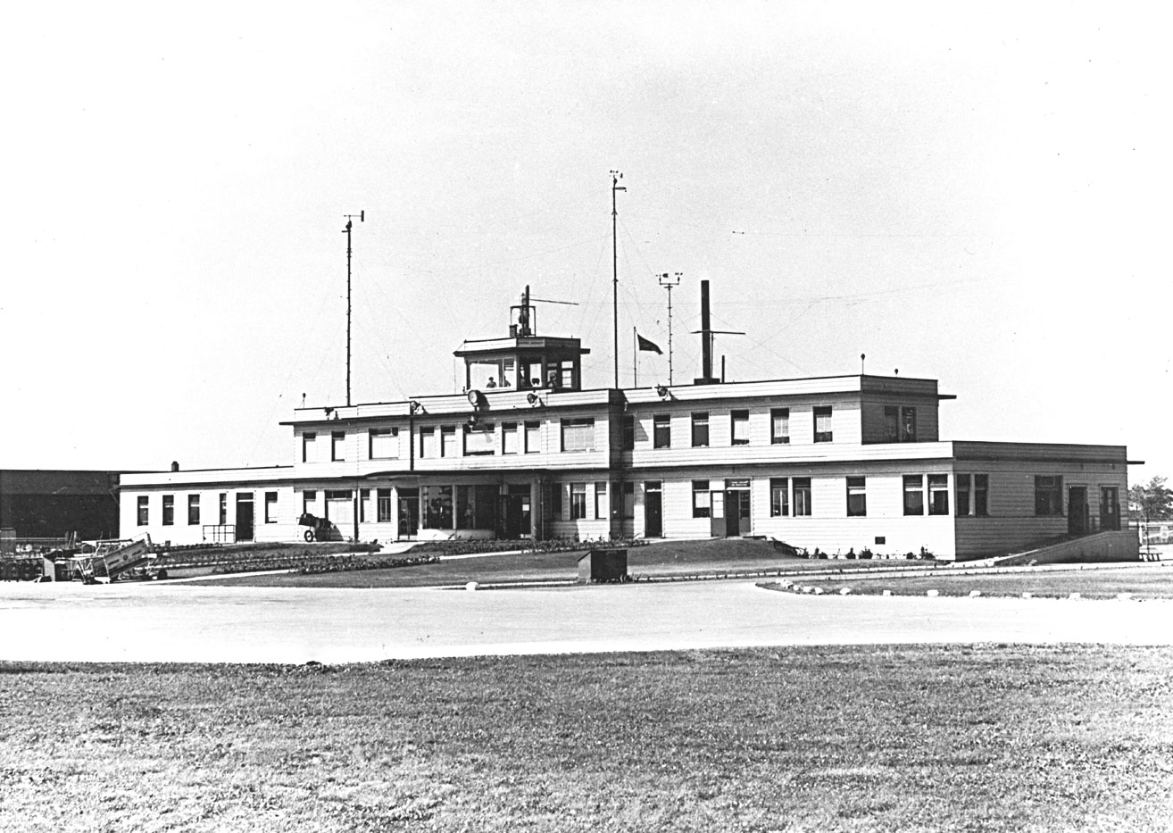
1959 – Toronto Airport, Canada

Slide 9
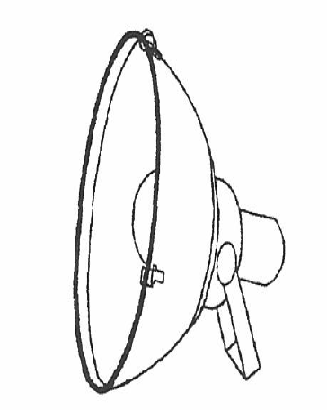
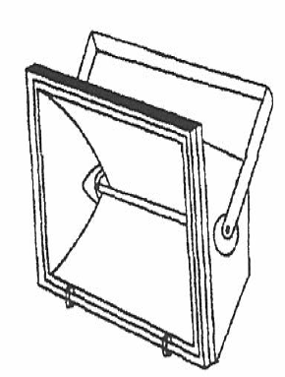
IES RP-37 last update before publication
Design Criteria
Selection of luminaire
?
A ?
B ?
C

Slide 10
IES RP-37 last update before publication
Design Criteria
Light Loss Factor (LLF)
LLF = LLD x LDD x BF x ATF
LLD - Lamp Lumen Depreciation – check for curve
LDD - Luminaire Dirt Depreciation – environmental condition, IES handbook and RP-08 contain information
BF - Ballast factor – related to regulation of current.
ATF - Ambient temperature factor. Check manufacturer

Slide 11
IES RP-37 last update before publication
Status of RP-37
Approx 90 pages, 50 graphics or pictures, + 10 tables, +60 references, +15 additional reading …
Document sent to IES editor since September 2014, went to RP-37 subcommittee, main Aviation Lighting Committee, IES technical review committee and IES board.
Close to 500 comments generated and review since last year.
IES Board comments received yesterday. Response next week!
Final approving on November 7-8, 2015 at IES annual conference
Graphic and set up for printing (2 weeks)
Last review from RP-37 subcommittee (2 weeks)
PRINTING or E version for Christmas!

Slide 12
IES RP-37 last update before publication
Recommendation
New working group to be formed to revised aviation related definition in IES RP-16. Looking for a task leader and members!
Terminology dated back 1980
Promotion: magazines and airport community
Open up for new membership RP-37 subcommittee
Q & A after publication
Next version
OSHA - coordination
FAA - tower control review
Task lighting
Others

Slide 13
New IES standards
DG-28-15 The Guide for Selection, Installation, Operations and Maintenance of Roadway Lighting Control Systems Design
RP-33-14 Lighting for Exterior Environments
More to come
DG-30 High Mast Lighting for Roadways
DG-26 Lighting the roadways in work zones
RP-07 Lighting Industrial Facilities

Slide 14
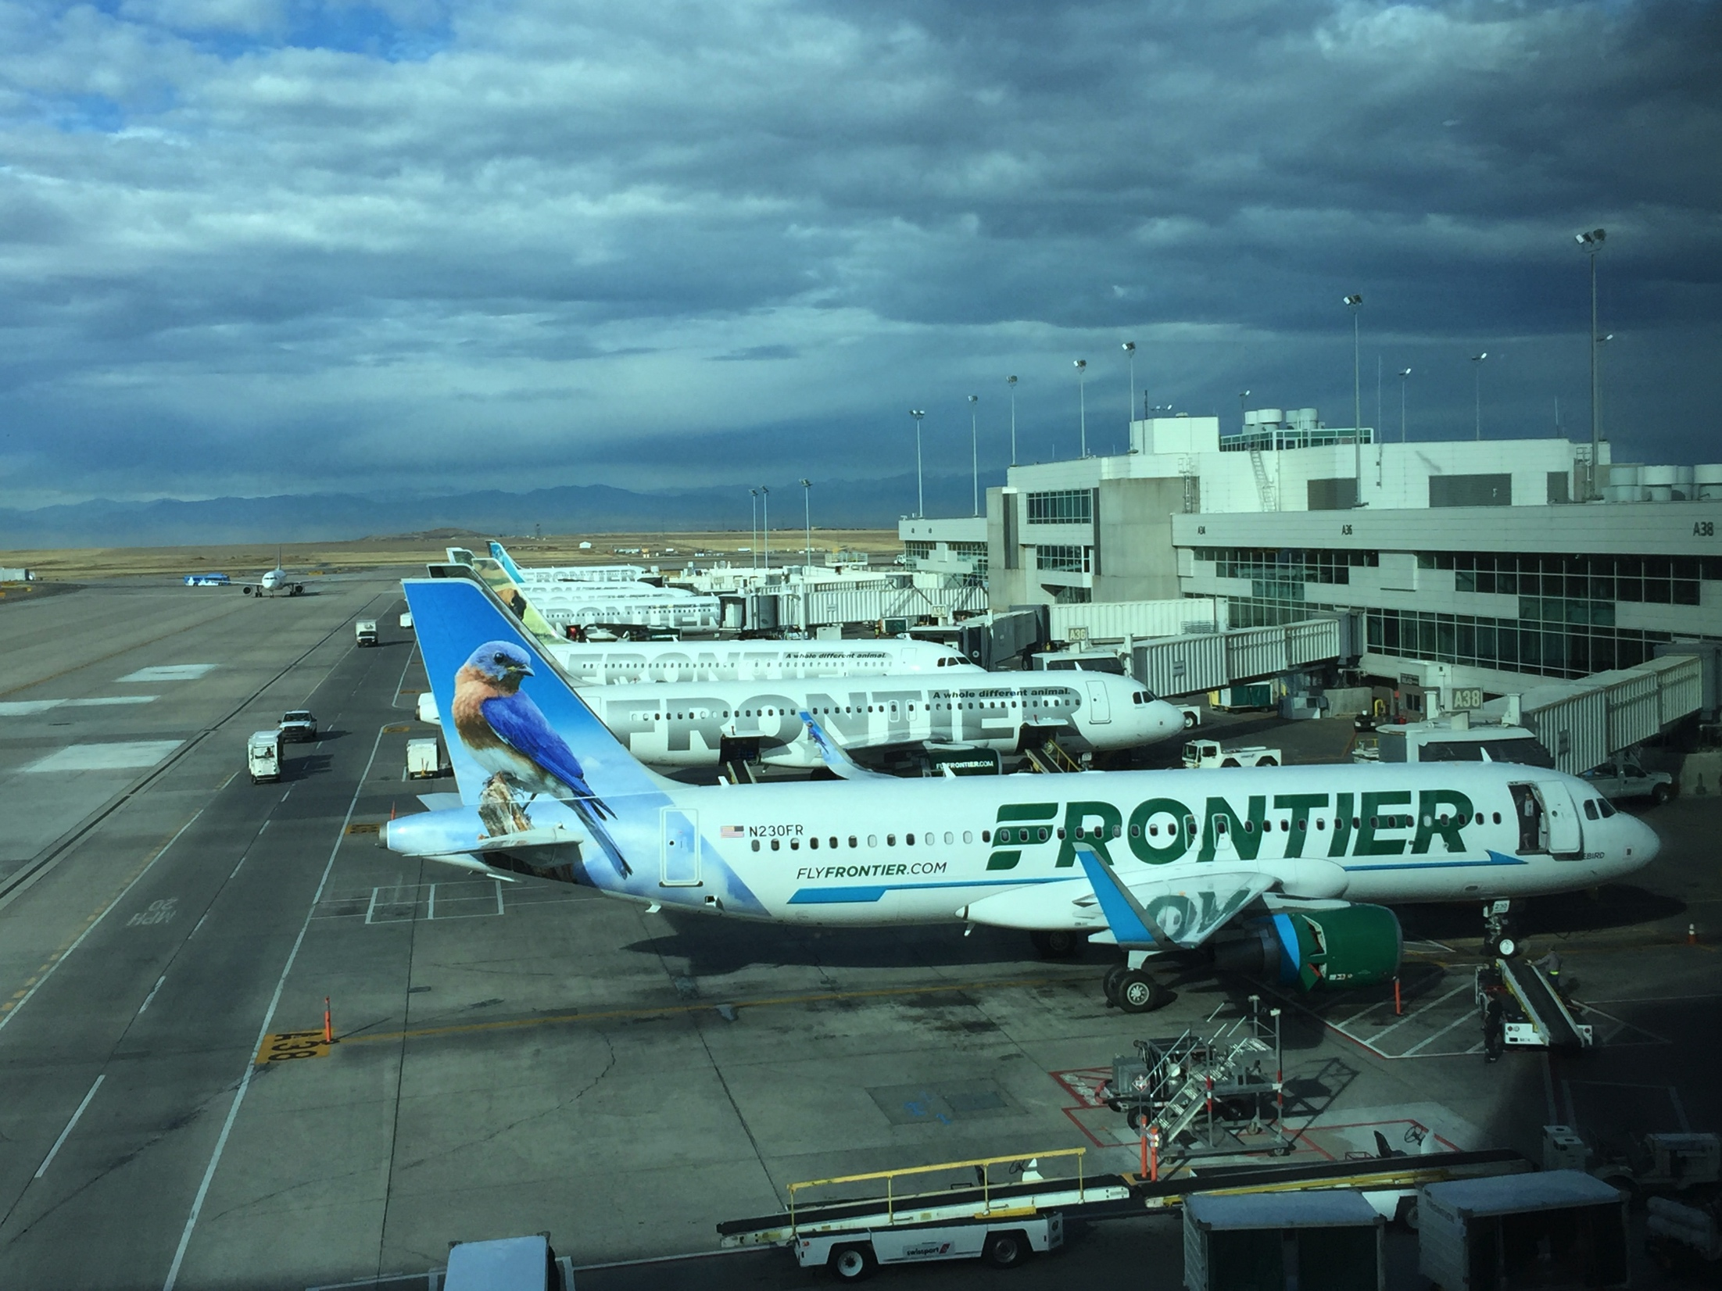
Question or comments?
Richard Larivée, ing, P.Eng. Chair IES RP-37
IESALC recommended practices subcommittee
practices@iesalc.org

